Slide 1
Minority Pipeline Initiative: Role of the Board To train, match, and elect professionals of color to nonprofit boards of directors
PRESENTED BY: Business Volunteers Unlimited
November 9, 2021

Slide 3
Minority Pipeline Initiative Task Force
Randell McShepard
RPM International, Inc.
Chairman
April Miller Boise
Eaton
Michael Bowen
Calfee
Gregory Brown
PolicyBridge
Paul Clark
PNC (retired)
Nicole Crews
Swagelok
Lauren Gliha
BVU
Blaine Griffin
Cleveland City Council
Vaughn P. Johnson
Cuyahoga County
Steve Millard
Greater Akron Chamber
Dr. Charles Modlin
The MetroHealth System
Marcia Moreno
Young Latino Network
Victor Ruiz
Esperanza, Inc.
Sharon Sobol Jordan
Unify Labs
Elizabeth Voudouris
BVU
Michael White
Jack, Joseph and Morton Mandel Foundation

Slide 4
Agenda
Welcome​
Housekeeping ​
Breakout Introduction Groups​
The Role of the Board: An Overview​
Panel: The Role of the Board​
Call to Action​
Closing

Slide 5
Minority Pipeline Initiative Sponsors

Slide 6
Housekeeping
We are utilizing Zoom Meeting today, and all attendees are muted upon entry.​ We encourage you to keep your video on for a more interactive virtual event.
To ask a question, use the Chat box. We will have time for Q&A at the end of the presentation.​
This session will be recorded and sent to attendees this week.

Slide 7
Breakout Introduction Groups

Slide 8
Context: DE&I on Nonprofit Boards
1

Slide 9
National Nonprofit Board Demographics*
 | Board Members | Board Chair | Chief Executive | Notes
People of color | 22% | 17% | 13% | On boards, people of color increased from 16% in 2017
White | 78% | 83% | 87%
Are you satisfied with your board’s level of racial/ethnic diversity? |  | 45% NO 55% YES | 66% NO 34% YES | Board chair’s satisfaction was 55% in 2015. Chief executive’s satisfaction was 31% in 2015.
Does your board represent the demographics of the population served by your organization? |  | 71% NO | 62% NO
*from Leading with Intent, A National Index of Nonprofit Board Practices, 2021

Slide 10
Board Recruitment Strategies Are Not Aligned with Diversity Goals
Top two methods for identifying new board members:
Board members’ personal or professional contacts (96%)
CEO/ED’s personal or professional contacts (88%)
There is a disconnect between attitudes and actions:
Slide courtesy of Jim Taylor, BoardSource

Slide 11
BVU's Nonprofit Stability Index - October 2021

Slide 12
Why is Diversity Important in the Nonprofit Board Room?
BETTER DECISION- MAKING​
MORE RESPONSIVE
STRONGER ACCESS
BETTER PIPELINE
MISSION ALIGNMENT
Diverse perspectives are better qualified to identify the full range of risk and opportunity​
Diverse boards reflect the communities they serve, which improves the ability to comprehend and respond to environmental and external changes and trends​
To resources that are important to achieving the mission​ diverse connections with policy makers, donors and collaborative partners​
Boards that are not diverse risk becoming stagnant​
Diversity is part of the organization’s mission and essential to develop and deliver programs that support the mission​
*excerpt from BoardSource’s Board Governance Index: Is Your Board “Normal”?, ​ (by Ruth McCambridge, January 2015​)
Notes:
Better decision making​ diverse perspectives are better qualified to identify the full range of risk and opportunity​
More responsive ​ diverse boards reflect the communities they serve, which improves the ability to comprehend and respond to environmental and external changes and trends​
Stronger access to resources that are important to achieving the mission​ diverse connections with policy makers, donors and collaborative partners​
Better pipeline​ boards that are not diverse risk becoming stagnant​
Mission alignment​ diversity is part of the organization’s mission and essential to develop and deliver programs that support the mission​

Slide 13
BVU| Minority Pipeline Initiative UPDATE
Supply & Demand
DEI Training
Board Matching Results
Demand
Over 400 requests from over 300 nonprofits
Supply
From 2014-2019, BVU matched 160 people of color (15%)
MPI Role of the Board- October 2020, April 2021, November 2021
Potential board candidates
150 attendees
Three trainings in 2020-2021 on operationalizing DEI in board room
Nonprofit senior staff
270 attendees
Overall board matching diversity 26% YTD 2021
40 elections to nonprofit boards in 2021

Slide 14
Nonprofit Sector Trends
2

Slide 15
Nonprofit Stability Index Findings (BVU, October 2021)
50% - board engagement has increased in the last 18 months
69% - no succession plan for senior leaders
Greatest challenges facing their organization in the next 3 years:
Transitioning from long-time board members to newer ones
Board engagement
“I need to convert people from SITTING on the board to
people SERVING on the board.
We really need a board shake-up at this time!”

Slide 16
Nonprofit Stability Index Findings (BVU, October 2021)
44% need to add staff but have recruiting challenges
51% say achieving 2022 budget goals will be more challenging
48% say they need to develop a new strategic plan
“Positioning the organization to recover from the pandemic and work into a "new normal" while ensuring stability of financial and human resources… Also remaining agile to address what is anticipated as growth in needs for our services.”

Slide 17
1
Proliferation of Nonprofit Organizations
Over 1.3 million active nonprofit organizations
Provide 11.4 million jobs
5.4% of GDP ($887 billion to US economy)
Nonprofits in Ohio: 40,521
3rd largest industry employer in the state
Nonprofits by county:
Cuyahoga | 15,599
Summit | 4,640
Lorain | 2,037
Lake | 1,591

Slide 18
3
Strategic and Financial Pressures
Increasing demand
Shrinking resources
Reduction in government funding
501-C3 “nonprofit” is tax status, not business model

Slide 19
Financial Models
FOR PROFIT:
Customer buys product
NONPROFIT:
Client pays partial or nothing
Price includes cost of doing business
Overhead and profits seen as necessary
Success=financial results
Rely on 3rd party to cover cost (donors and funders)
Overhead and profits seen as unrelated to achieving mission
Success=mission impact
On average, successful for-profit companies allocate 25% of budget to overhead.*

Slide 20
4
Strategic Alliances
Economies of scale
Avoid duplication
Sustainability
68% collaborate to provide programs
5
Increased Scrutiny and Transparency
Outcome metrics
990
Executive Compensation

Slide 21
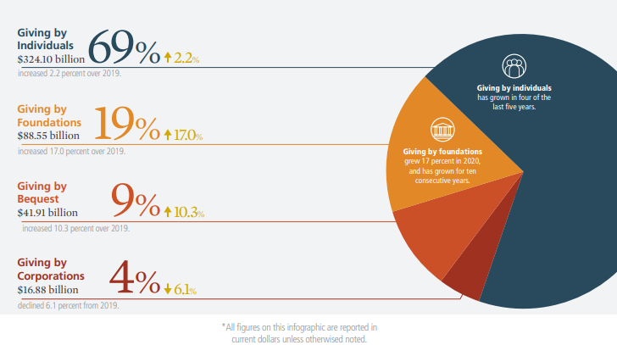
Funding Trends - Charitable contributions are significant source of revenue
$471.44 billion
In 2020, Americans gave $471.44 billion to charity, a 5.1% increase over 2019.
5%
2%
4%
6%
10%
28%
17%
9%
69%
12%
12.5%
SOURCE: Giving USA 2021

Slide 22
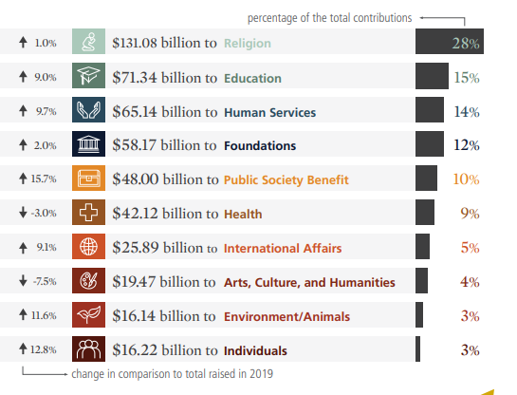
Funding Trends - Charitable contributions are significant source of revenue
$471.44 billion
In 2020, Americans gave $471.44 billion to charity, a 5.1% increase over 2019.
5%
2%
4%
6%
10%
28%
17%
9%
69%
12%
12.5%
2020 contributions by destination (by percentage of the total)
SOURCE: Giving USA 2021

Slide 23
The Role of the Board of Directors
3

Slide 24
Authority
The board of directors bears the primary responsibility for ensuring that a charitable organization fulfills its obligations to the law, its donors, its staff and volunteers, its clients, and the public at large.
Basic authority (§1702.30(A), O.R.C.):
“all of the authority of a corporation shall be exercised by or under the direction of its directors.”

Slide 25
The Board Functions as a Team
The role of the board refers to the board as a whole, a unit, a team. Individual board members do not have authority or individual rights
Accountability and responsibility rests with the full board…
Not the Chair
Not the CEO
Not individual board members

Slide 26
1
Determine mission, vision and strategic direction
Scan internal and external environment
Review and modify strategic plan
Monitor performance based on key milestones and success factors
2
Establish and strengthen community relations
Ambassadors
Talking points
Crisis/transition communications strategy

Slide 27
3
Select and support the chief executive
Partnership
CEO performance evaluation and process to set compensation (990 requirement)
Succession plan
Open doors
4
Develop funding resources
Individual, annual, financial contribution
Donor identification
Donor cultivation

Slide 28
5
Provide financial oversight
Adequate accounting skills
Annual budget
Regular financial statements and cash flow reports
Annual audit
Investment policies
6
Ensure legal and ethical integrity
Duties of care, loyalty and obedience
Board has the authority as a group, not as individual members
96% of nonprofits carry Directors and Officers Liability Insurance for their boards

Slide 29
7
Develop the board
Governance Committee
Adopt best practices
Review and update bylaws periodically

Slide 30
There Is a Great Difference Between Sitting on a Board and Serving on a Board.

Slide 31
Best Practices of Governance
4

Slide 32
1
Define the unique “work” of your board
Lifecycle of nonprofit
2
Strengthen board member engagement
Clarify expectations and accountability (81% have written job descriptions for board members; 52% conduct annual assessment)*
Orientation
Engage new board members on at least one committee right away
Buddy system
*excerpt from BoardSource’s Leading with Intent.
(2019)

Slide 33
3
Build constructive partnership with the CEO
Annual compensation and evaluation process – 80%
Open and honest communication
Annual one-on-one meeting
4
Structure effective meetings
Set dates early; begin and end ON TIME
Engaged board members do their HOMEWORK BEFORE board meetings
Board portal
Consent agenda – 57%
Dashboard report – 44%
Executive Session – 61%

Slide 34
5
Ensure relevant board and committee structure
Average number of committees – 4.8
Average number of board meetings – 6
Executive Committee – 78%
Average board tenure – 6 years (2 three-year terms)
6
Seek competent and diverse board composition
Average board size – 15 members
Race/ethnicity – 84% Caucasian
Age – 17% under 40 years old

Slide 35
7
Effective communication and deliberation
Create culture of trust, transparency and inquiry
Ensure that board functions in all three modes:
Fiduciary: Legal responsibility for oversight and stewardship
Strategic: Ensure a winning strategy; decisions about resources and programs
Generative: Serve as source of leadership & deeper inquiry; explore root causes, values, optional courses and new ideas
8
Succession plan for the chief executive and the board chair
34% have a written CEO Succession Plan
Qualities to seek in a board chair:
Ability to build constructive partnership with CEO
Fosters trust
Resolves conflicts, builds consensus
Frames and discusses strategic questions
Establishes clear expectations for board members

Slide 36
“
Board members should not feel like “docile mushrooms (warm and in the dark).”
“
McFarlan and Epstein
Nonprofit Boards: A Guide, 2009

Slide 37
Resources for Board Members
Business Volunteers Unlimited (BVU)
BoardSource
Independent Sector
Nonprofit Finance Fund
www.boardsource.org
www.independentsector.org
nonprofitfinancefund.org
www.bvuvolunteers.org

Slide 38
Board Service Readiness? YES/NO
I am interested in advancing a cause that I feel excited about.
2. I am curious to learn about issues facing our community.
3. I am interested in learning about leadership in a new environment.
4. I am interested in meeting people outside my usual professional and social circle.
5. I am comfortable making a personal contribution to a nonprofit organization.
6. I can imagine asking others to contribute financially to a cause that I am passionate about.
7. I have enough autonomy in my schedule to accommodate board and committee meetings.
8. I am patient and collegial when working as part of a team.
9. I can commit the time necessary to be an exceptional board member.
*excerpt from BoardSource

Slide 39
Sample Question to Explore Board Opportunity
Meeting with the chief executive and board chair to discuss:

Mission and scope of programs

Revenue structure and key funding sources

Key challenges facing the organization in next 3 years

Key opportunities for organization growth

Strategic plan

Relationship between chief executive and board

Role of the board

Expectations of individual board members ($, time, events)

D&O insurance

Tour of facilities

Slide 40
Panel Discussion
5

Slide 41
Panel Discussion

Slide 42
Next Steps: How to Get Involved
6

Slide 43
Call to Action
Be part of the solution by taking action.
Serving on boards is not just for corporate executives
Boards need diverse voices that are smart, engaged, and unabashedly committed to Cleveland and Northeast Ohio

Slide 44
Key Things to Consider
1. Expectations: board & committee meetings| personal contribution & fundraising | multi-year commitment
2. Mission: causes that are meaningful to you personally
3. Skills: how will you make an impact?

Slide 45
Next Steps
Complete the interest form in the chat.
2. BVU will follow up in the coming days.
3. Attend Board CONNECT session (30 minutes) and talk with BVU about nonprofits in your interest areas.
4. Meet with one or two organizations. Learn about programs & services and how you can get involved.
5. Share updates with BVU.

Slide 46
Minority Pipeline Initiative Sponsors

Slide 47
Thank you
BVU connects businesses and nonprofits, creating connections to better our community.
@bvuvolunteers
linkedin.com/company/bvu
facebook.com/bvuvolunteers
flickr.com/photos/bvu

