Slide 1
Succession Planning: Demystifying Succession Planning and Why it Matters
Julie Clark Vice President, Nonprofit Engagement, Business Volunteers Unlimited
Andrea Wlaszyn
Director, Business Engagement, Business Volunteers Unlimited
In partnership with:
Notes:
Add CFLC sponsored by

Slide 2
Housekeeping
We are utilizing Zoom Meeting today, and all attendees are muted upon entry.​ We encourage attendees to keep their video on for a more interactive virtual event.
Use the CHAT BOX to ask questions. Feel free to ask questions throughout the presentation. Additionally, we will have time for Q&A at the end of the presentation.​
This session will be recorded. The slide deck and recording will be shared with attendees post event.

Slide 3
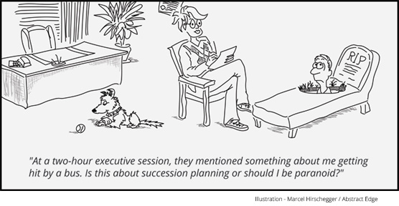

Slide 4
Objectives for Today
Context: Why is succession planning important?
Planning for succession
Elements to consider:
Strategic plans
Job descriptions
Recruiting approaches
Performance management
The Chief Executive

Slide 5
Model for Managing Talent
Competencies
Performance Management
Succession Planning
Performance Management
Learning Management
Career/Succession Planning
Compensation
Talent Acquisition
Have It?
TALENT DEMAND
Build It?
Acquire It?

Slide 6
Value of Succession Planning
Nonprofits fill fewer senior roles internally…
but turnover at thetop is material…
so proactive planning is a necessity.
Nonprofits
Nonprofits must focus on HR processes and benchmarks:
Invest in leadership capacity
Evaluate management compensation
Explore new talent pools
30-40%
Businesses
Half of nonprofit CEOs/Executive Directors plan to leave their positions within the next 5 years¹
60-65%
Note: (1) Leading with Intent: A National Index of Nonprofit Board Practices 2017 Board Source
Notes:
Flattened organization structures have developed in NP’s limiting # of internal successors with broad experience base.

Slide 7
Waging the War for Talent
4% of new hires leave after a disastrous first day
50% of new hires in leadership roles leave within 5 years
40% of senior managers hired from outside fail within 18 months
64% of new executives hired from outside will fail
Source: Society for Human Resource Management

Slide 8
The Value of Succession Planning
Ensure the long term sustainability of the organization’s mission and impact to the community
Identify future leaders
Understand the depths or limits of your talent pool
Identify potential vulnerabilities and risks within the organization
More effectively manage changes of key personnel
Identify skill gaps and manage development
Motivate individuals by stretching their abilities

Slide 9
Benefits of Having a Succession Plan
For the organization:
Identifies future leaders
Ensures we have the right people in place
For staff leadership:
Ensures the “right people are in the right seats”
Identifies potential risks within the organization
More effectively manage changes of key personnel with stakeholders
For the individual:
Identifies skill gaps and manages development
Motivates/stretches

Slide 10
Leadership Succession Caution Zone
Strong CEO
Owns most critical relationships
Has not transferred important knowledge
CEO dependency – CEO takes on too much of the organization’s work
Extremely high level of trust and capabilities
Long tenure
Organization has grown up around the leader
Compensation is lower than market value
Limited internal talent
Aging workforce
No emergency succession plan
Board is not functioning well
Notes:
Add “caution” road sign image.

Slide 11
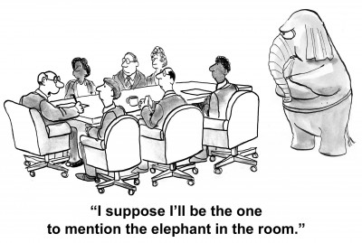

Slide 12
Types of Succession Planning
Emergency/Urgent Need
Departure without notice
Long-term absence
Planned/Departure-Defined
Future planned retirement or departure

Slide 13
Responsibility for Succession Planning
The Board
Develop a succession plan for the chief executive
The Chief Executive:
Maintain an organization-wide succession plan and regularly update
Hold the Executive Team accountable for staff development
The Executive Team:
Manage development of direct reports
Identify cross-training and cross-functional development opportunities
Provide mentoring, guidance, and feedback
HR Function:
Ensure development plans for all succession candidates
Provide oversight for ‘high potential team’ and unique development needs

Slide 14
Succession Planning Concerns
Sense of being replaced
Resistance to change
Internal and external messaging
Board and staff buy-in
Time and resources
Attention to diversity and inclusion and compliance issues
Notes:
Time and reseoruces: Allowing for employee learning curves (i.e. errors/mistakes)

Slide 15
Succession Planning Process – Key Steps
Assess Organization
Identify the critical roles and skills required to meet future needs
Assess Employees
Assess employees and identify potential successors for critical roles
Develop Employees
Determine if skills development is required to prepare employee for future
Place/Recruit Employees
Plan recruitment and manage placement of identified candidates

Slide 16
Assess the Organization
Identify the roles to be included.
For each key role, prepare updated position descriptions that include required skills, education, and experience.
Standard roles often included:
Executive Director or President/CEO
Program Management
Development Lead
Finance/Administrative Lead
Additional key roles should be identified based on the risk profile.
Evaluate current team and identify potentials that could fill the job.
CAREFULLY manage expectations. (Avoid perceived promises of future career progression.)
Notes:
Ensure incumbents are actively involved in the planning process.

Slide 17
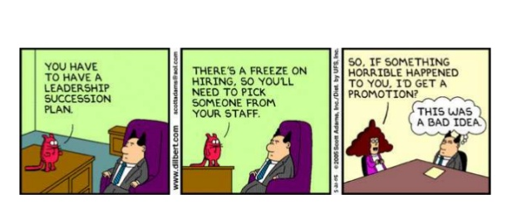
Assess & Develop Employees

Slide 18
Assess & Develop Employees
Individual Development Plans
Comprehensive
Revisit it periodically
Tie to SP and strategic initiatives
Organizational Needs and Direction
Employee Development
Personal Career Aspirations
Targeted Development
Shadowing
Training
Special Assignments
No promises should be made about future roles for the employee
Individuals should receive the appropriate messages regarding their future
Notes:
Ensure people targeted for leadership are gaining the right experience and skills.
Job rotations
Job shadowing
Task force assignments or special projects to stretch current skills
No promises should be made about future roles.
Individuals should receive the appropriate messages regarding the future:
You are a valued member of the organization.
You are demonstrating strong leadership potential.
With the right skill-building and experiences, you could be one of the future leaders of this organization.
We need to make sure you get the right experiences in your current position and build the skills necessary for the next one.

Slide 19
Place/Recruit Employees
EVALUATE THE PIPELINE OF CANDIDATES:
The “Win the Lottery” scenario – need to have interim leadership identified
Depth
The pipeline should include 3 potential successors, when possible.
Consider diversity – look at the make-up of individuals in the pipeline. Does it resemble the overall composition of the organization?

Slide 20
Place/Recruit Employees
If the talent does not exist internally, use your network to source candidates.
Board involvement:
Board/Committee Responsibility for CEO
Board networks for positions
Consider a recruiter if…
You can afford one
The role is difficult to fill
The position is high risk if not filled quickly
Diversity – Consider organizational diversity efforts.
Emergency Succession –
Ensure that interim leadership is identified for critical functions.

Slide 21
Elements of a Effective Succession Plan
Essential functions of a position
Leadership capabilities
Necessary licenses, education, etc.
Emergency plan coverage – interim successor for each key responsibility
2-3 potential long-term successors
Rates long-term successors based on preparedness and identifies skills/experience gaps
Development plan for internal candidates

Slide 22
Common Functional Capabilities for a Nonprofit CEO
Deep understanding of specific industry (arts, mental health, education, etc.)
Financial acumen
Management skills (HR and general management)
Fundraising
Board management
Excellent communications – public speaking, written
Strategic planning
Marketing sensibility

Slide 23
Common Leadership Traits for a Nonprofit CEO
Mission-driven
Visionary
High level of integrity
High level of emotional intelligence
Good decision-making skills
Collaborator
Team builder
Change agent
Risk taker
Stress-tolerant
Persuasive

Slide 24
What attributes does your next CEO need to have?
It depends on where your organization is going!

Slide 25
The Future Direction of Your Organization
Changes/external factors
Financial health
Organization structure & workforce
Organizational culture
Quality metrics
Notes:
Strengths:
What does your organization do well?
Your niche in the market
Knowledgeable and committed staff
Good funding record
Vulnerabilities and areas of concern:
Inadequate transfer of knowledge
Organization risks
Changes in funding
Organization pain points (process improvement, tech, staff capacity, leadership, busy cycles)

Slide 26
Interim Succession
GETTING READY FOR AN IMMEDIATE TRANSITION
Document critical processes
“Where are the keys?”
Important phone numbers
Computer passwords
Numbers for bank accounts and attorneys

Slide 27
Reasons to Consider Hiring an Interim CEO
The organization is under duress
CEO leaves unexpectedly
There is not an internal candidate ready to step into the role
The board requires time to find the right next leader
The organization is considering a merger or structural change

Slide 28
Recommendations on Search/Succession Strategies for the CEO
Establish search, interview, and hiring process and timeline.
Develop a formal communication strategy to announce search and process, especially with funders and key stakeholders.
Establish Search Committee of the Board.
Determine if Board should engage outside search firm.
Gather input from key stakeholders.
Identify top 3 to 5 strategic objectives that fall under CEO’s responsibility.
Identify and agree upon 7 to 10 most critical competencies required to tackle strategic objectives.
Agree upon the compensation package before the search begins.
Consider inviting a number of individuals to apply.
Identify Board and staff members to meet top candidates.
Develop interviewer strategy and roles.

Slide 29
Wrap-Up
Succession planning is a best practice and important to ensure sustainability for an organization.
The board has responsibility for the chief executive’s succession plan, and the chief executive has responsibility for all other staff plans.
Think both emergency/short-term and long-term.
Consider not only current state of organization, but where your organization is going in the future.
Never make any promises.
The strongest succession plans have several candidates identified and include development needs.

Slide 30
Questions
THANK YOU!
If you have any questions, please contact:
Julie Clark jclark@bvuvolunteers.org
Andrea Wlaszyn awlaszyn@bvuvolunteers.org

Slide 31
Ask the Expert
Upcoming Events:
Dates: October 12-13 and November 16-18
During Ask the Expert, nonprofits are paired with skills-based volunteers to work together on projects in various areas.
60-minute one-on-one meetings – an opportunity to work on a small project or get practical suggestions/guidance
Let us know what kind of assistance you are looking for and we’ll do our best to find an “expert” to help!
Sign up today by contacting Community Foundation Lorain County!

Slide 32
2021 Nonprofit Leadership Summit
Thriving, Inclusive, Diverse Boards
A four-part series aimed at improving your nonprofit board and management
Thursdays in October (Oct. 7, 14, 21, 28) from 11:00 AM to 12:30 PM
Virtual sessions on:
Integrating DEI into board culture
Being a brand ambassador and advocate
Implementing leading practices for board recruitment & engagement
Choreographing effective and impactful meetings
Limited time - $40 early bird rate
https://bvuvolunteers.org/nonprofit-summit-2021

Slide 33
Role of the Board virtual training
Date: Friday, September 10, 8:30 – 11:00 AM
Audience: Current & Prospective Board Members, staff that support nonprofit boards
Current trends/challenges in the nonprofit sector
Roles and responsibilities of nonprofit boards
Panel discussion with an executive director, attorney, and business leader
FREE for BVU members / $25 for non-members
https://bvuvolunteers.org/event/virtual-role-of-the-board-training-3/

Slide 34
Thursday, September 16th 8am-8pm

Slide 36
BVU engages, connects, and strengthens businesses, nonprofits, and the community.
@bvuvolunteers
linkedin.com/company/bvu
facebook.com/bvuvolunteers
flickr.com/photos/bvu
Thank you!

