Slide 1

Nonprofit Leaders’ Breakfast
Featuring John Corlett,
The Center for Community Solutions

Slide 2

Thank you to our sponsor!

Slide 3
Housekeeping
We are utilizing Zoom Meeting today, and all attendees are muted upon entry.​ We encourage attendees to keep their video on for a more interactive virtual event.
To ask a question to the presenter use the Chat box. We will have time for Q&A at the end of the presentation.​
This session will be recorded and sent to attendees this week, along with the slide deck.

Slide 4
Today’s Presenter:
John R. Corlett, President and Executive Director, Community Solutions
John Corlett serves as the President and Executive Director of The Center for Community Solutions. Corlett’s career has included leadership roles in both the public and private sectors, including serving as vice president for government relations and community affairs at The MetroHealth System, and as the State of Ohio’s Medicaid Director. He has also held leadership roles in community organizations focused on families, children, behavioral health and women’s health. He serves on the Board of Directors of The Centers for Families and Children, The Greater Cleveland Food Bank and the Woodruff Foundation. He has been the recipient of many state, regional and local awards. Corlett holds a Bachelor of Specialized Studies from Ohio University.

Slide 5

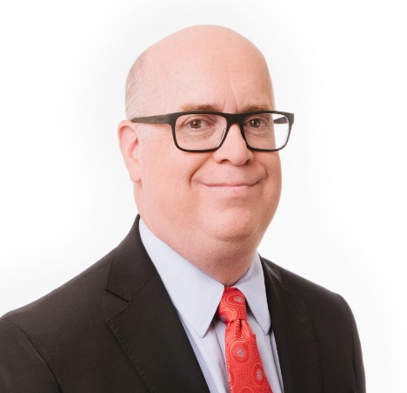


American Rescue Plan Act Funding in Ohio
Business Volunteers Unlimited: Nonprofit Leaders’ Breakfast
July 15, 2021
John R. Corlett
President and Executive Director
@CommunitySolsED
jcorlett@CommunitySolutions.com

Slide 6
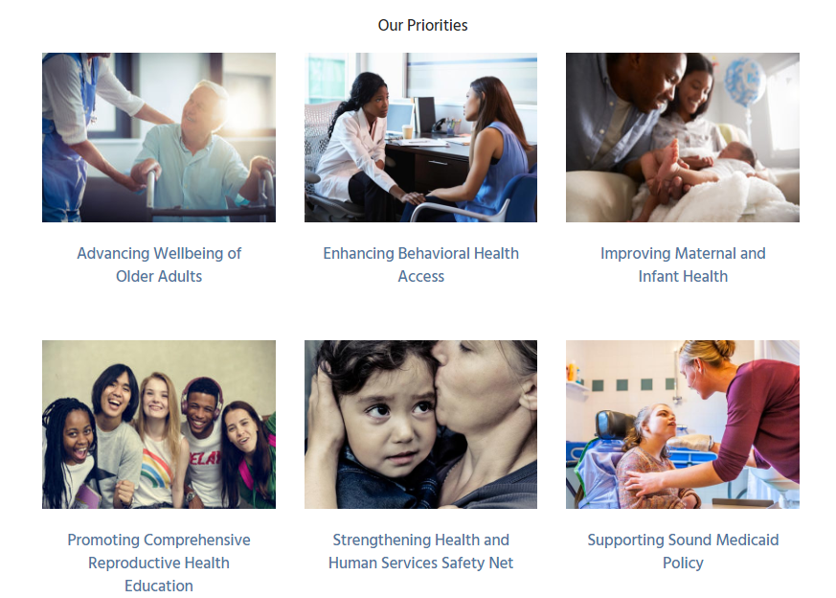

The Center for Community Solutions
We are a nonprofit that improves health, social and economic conditions through nonpartisan research, policy analysis, communications and advocacy.
www.CommunitySolutions.com

Slide 7

How Much Is Coming to Ohio in Fiscal Relief Funds?
State of Ohio 5,368,387
Ohio Counties 2,270,471
Ohio Metro Cities 2,175,200
Ohio Non-Metro Cities 843,7272
TOTAL $10,657,785

Slide 8
Ohio Has Already Spent Much of the First Payment
$1.5 billion to repay loans to the federal government for unemployment compensation.
$422 million to Ohio Townships who weren’t eligible for direct aid.
$250 million to establish a water and sewer quality program administered by the Ohio Department of Development.
$84 million to support infrastructure improvements at pediatric behavioral health care facilities to improve inpatient and outpatient settings.
$2.256 billion
Source, H.B. 168

Slide 9
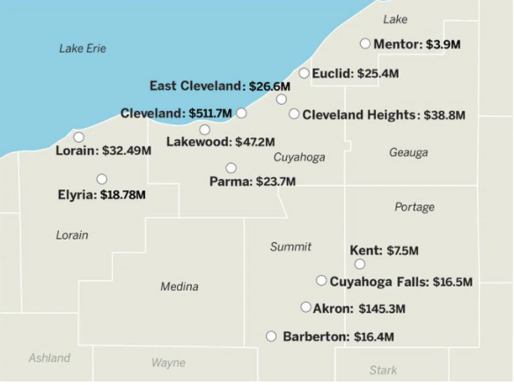
How Much Money Locally?
City of Cleveland $511 million
Cuyahoga County $239 million
Geauga County $18 million
Lake County $44 million
Lorain County $60 million
Lakewood $47 million
Cleveland Hts. $38 million
East Cleveland $26 million

Slide 10
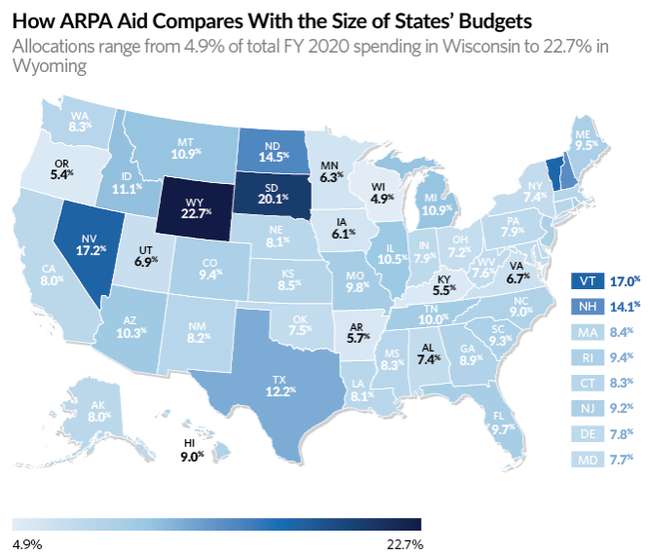
Putting Ohio’s Funding in Perspective
Ohio’s spending equals roughly 7.2% of its annual operating budget; allocation formula favored smaller states w/ recoveries that lagged.

Slide 11


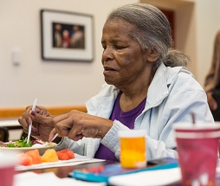
Ohio Is Receiving an Additional $29.4 Billion; Across a Broad Range of Programs
WIC, Child Care, Surplus Commodities, Higher Ed, K-12 Education, Child Welfare, Head Start, Older Americans Act, Energy Assistance, Home Delivered Meals, Family Planning, Public Health, Community Health Centers, Ryan White, Hospitals, Mental Health Block Grant, Comm. Dev. Block Grant, Public Housing, Rental Assistance, Arts, Justice Assistance Grants, Transit, and more

Slide 12
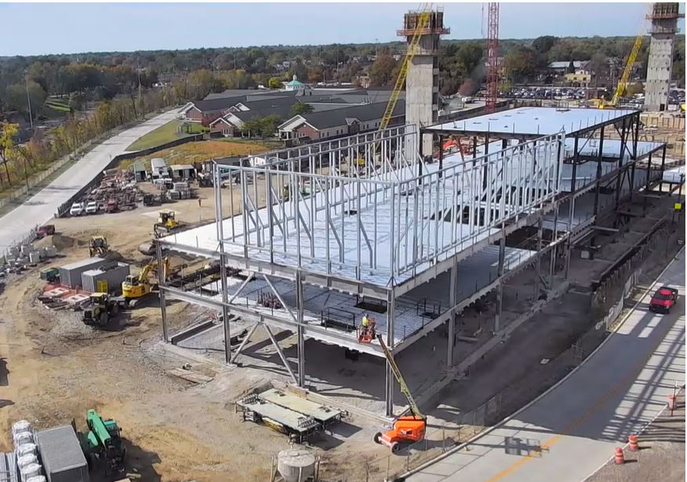
Ohio Will Receive $274 Million in State Capital Funds
Purpose of funds are for “critical capital projects directly enabling work, education, and health monitoring, including remote options, in response to the public health emergency with respect to the Coronavirus disease”

Slide 13

American Rescue Plan Reporting Requirements
Governments must file an interim fiscal recovery fund report by August 31, 2021
Subsequently, quarterly reports will be required.
Reports will include financial data, info on contracts and subawards over $50,000, types of projects funded, and related info.
Ohio, Cuyahoga County and the City of Cleveland are required to file an annual recovery plan performance report (must be posted online)
Requirements will likely evolve further

Slide 14

American Rescue Plan Act FAQs
How much flexibility is provided ?
A lot, the U.S. Treasury provides broad flexibility to decide how to use the fiscal relief funding.

Slide 15
American Rescue Plan Act FAQs
Can funds be transferred to non-profit organizations?
Yes, but govt. has to ensure subrecipient complies with all reporting requirements.

Slide 16
American Rescue Plan Act FAQs
What is the time period for using funds?
Funds can be used to cover costs incurred beginning 03/03/21. All funds must be spent or “obligated” by the last day 12/31/24. All funds should be expended by 12/31/26.

Slide 17

American Rescue Plan To Do List
Draft your request for support (case statement)
Line request up against U.S. Treasury guidance
Ask yourself, is it a one-time or on-going
Understand what funds you are seeking
Reach out to agency professional staff
Get ready to lobby

Slide 18


Stay Informed
The Center for Community Solutions plans to track and influence how funds are invested. We will be posting and sharing information via our website (www.communitysolutions.com) and our weekly e-newsletter 5 Things You Need to Know This Week.

Slide 19

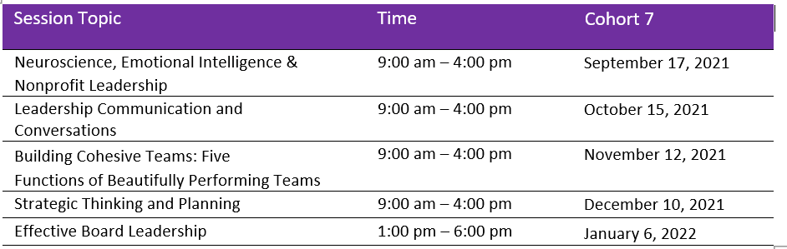
How BVU Serves Nonprofits | Nonprofit Leadership
Nonprofit Leadership Advancement Program (NLAP)
A Five Part Development Series for Nonprofit Leaders
Recommends and prepares candidates for board positions
Based on needs expressed by nonprofit organizations, and interests and abilities of individual candidates
BVU and Ratliff & Taylor have graduated six cohorts from the leadership program which includes over 75 nonprofit leaders.
https://bvuvolunteers.org/nonprofitleadershipadvancementprogram/

Slide 20
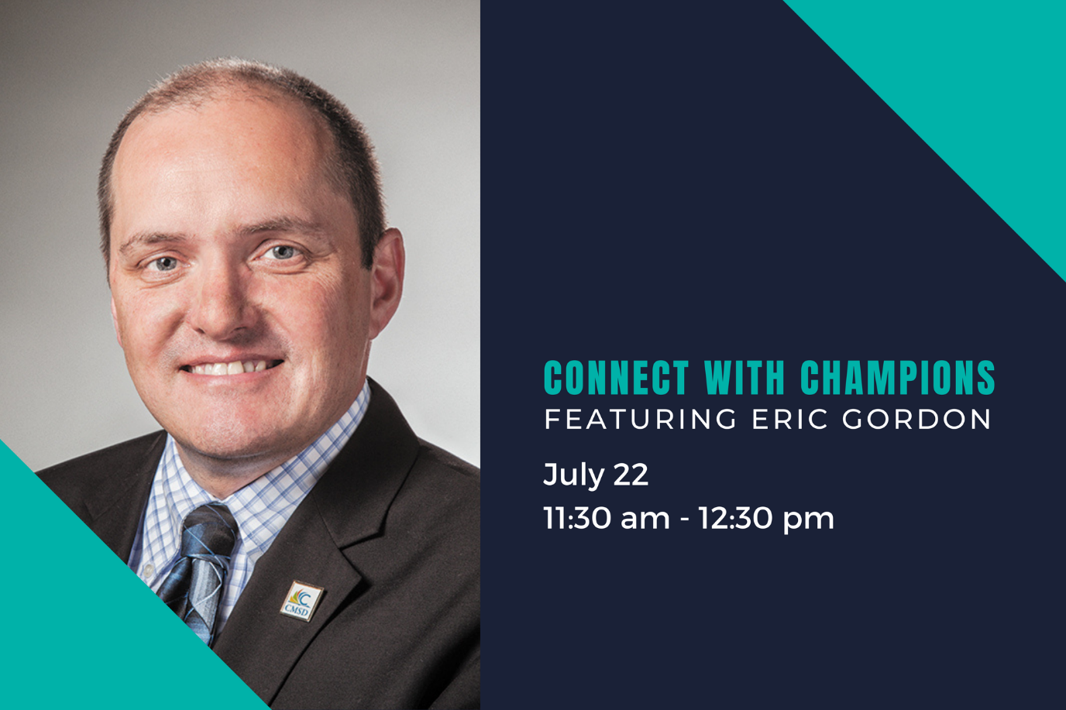
Connect with Champions
Join us for this lunchtime conversation as CMSD CEO Eric Gordon talks about his career path, his commitment to our community’s children, and how each of us (and our organizations) can play a vital role in CMSD’s success.
FREE Zoom event - Register today!
https://bvuvolunteers.org/event/brunch-with-champions-featuring-eric-gordon-2/

Slide 21

Ask the Expert
August 16-19
FREE 60-minute sessions with an expert to jump-start a project
or discuss and problem-solve a challenge.
Topics include:
  QuickBooks
  Risk Management
  Executive Coaching
  Nonprofit Accounting & Reporting
  Marketing/Communications/Branding
  Telecom & Internet Options
  Accessibility
  LinkedIn training
Learn more: https://handson.bvuvolunteers.org/asktheexpertevents

Slide 22
Thank you to our sponsor!

Slide 23




Thank you
BVU connects businesses and nonprofits, creating connections to better our community.
@bvuvolunteers
linkedin.com/company/bvu
facebook.com/bvuvolunteers
flickr.com/photos/bvu

