Slide 1
Role of the Board Prepared for: Corning Incorporated Foundation & Southern Tier Nonprofits
Prepared by: Elizabeth Voudouris,
President & CEO, Business Volunteers Unlimited
evoudouris@bvuvolunteers.org

Slide 2
Sector Trends
1

Slide 3
1
Proliferation of Nonprofit Organizations
Over 1.3 million active nonprofit organizations
Provide 11.4 million jobs
5.4% of GDP ($887 billion to US economy)
Nonprofits in New York: 115,982
Employee 2 million people
$322 billion in revenue
Assets of $633 billion

Slide 4
2
Strategic and Financial Pressures
Increasing demand
Shrinking resources
Reduction in government funding
501-C3 “nonprofit” is tax status, not business model

Slide 5
Financial Models
FOR PROFIT:
Customer buys product
NONPROFIT:
Client pays partial or nothing
Price includes cost of doing business
Overhead and profits seen as necessary
Success=financial results
Rely on 3rd party to cover cost (donors and funders)
Overhead and profits seen as unrelated to achieving mission
Success=mission impact
On average, successful for-profit companies allocate 25% of budget to overhead.*

Slide 6
3
Strategic Alliances
Economies of scale
Avoid duplication
Sustainability
68% collaborate to provide programs
4
Increased Scrutiny and Transparency
Outcome metrics
990
Executive Compensation

Slide 7
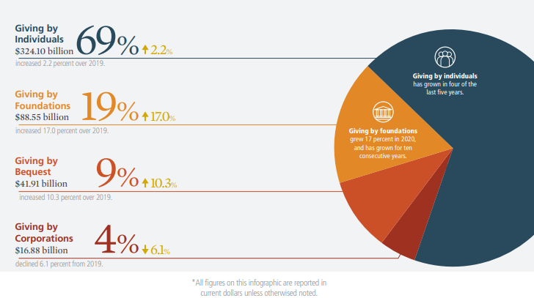
Funding Trends - Charitable contributions are significant source of revenue
$471.44 billion
In 2020, Americans gave $471.44 billion to charity, a 5.1% increase over 2019.
5%
2%
4%
6%
10%
28%
17%
9%
69%
12%
12.5%
SOURCE: Giving USA 2021

Slide 8
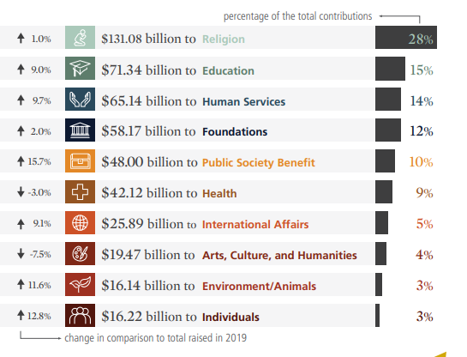
Funding Trends - Charitable contributions are significant source of revenue
$471.44 billion
In 2020, Americans gave $471.44 billion to charity, a 5.1% increase over 2019.
5%
2%
4%
6%
10%
28%
17%
9%
69%
12%
12.5%
2020 contributions by destination (by percentage of the total)
SOURCE: Giving USA 2021

Slide 9
The Role of the Board of Directors
3

Slide 10
Authority
The board of directors bears the primary responsibility for ensuring that a charitable organization fulfills its obligations to the law, its donors, its staff and volunteers, its clients, and the public at large.
Basic authority (§1702.30(A), O.R.C.):
“all of the authority of a corporation shall be exercised by or under the direction of its directors.”

Slide 11
The Board Functions as a Team
The role of the board refers to the board as a whole, a unit, a team. Individual board members do not have authority or individual rights
Accountability and responsibility rests with the full board…
Not the Chair
Not the CEO
Not individual board members

Slide 12
1
Determine mission, vision and strategic direction
Scan internal and external environment
Ensure effective planning - review & modify strategic plan
Monitor performance based on key milestones and success factors
2
Establish and strengthen community relations
Enhance the public standing of your organization
Ambassadors
Talking points
Crisis/transition communications strategy

Slide 13
3
Select and support the chief executive
Partnership
CEO performance evaluation and process to set compensation (990 requirement)
Succession plan
Open doors
4
Develop funding resources
Ensure adequate resources
Individual, annual, financial contribution
Donor identification
Donor cultivation

Slide 14
5
Provide financial oversight
Adequate accounting skills
Annual budget
Regular financial statements and cash flow reports
Annual audit
Investment policies
6
Ensure legal and ethical integrity
Duties of care, loyalty and obedience
Board has the authority as a group, not as individual members
96% of nonprofits carry Directors and Officers Liability Insurance for their boards

Slide 15
7
Develop the board
Ensure a competent board
Governance Committee
Adopt best practices
Review and update bylaws periodically

Slide 16
There Is a Great Difference Between Sitting on a Board and Serving on a Board.

Slide 17
Best Practices of Governance
4

Slide 18
1
Define the unique “work” of your board
Lifecycle of nonprofit
2
Strengthen board member engagement
Clarify expectations and accountability (81% have written job descriptions for board members; 52% conduct annual assessment)*
Orientation
Engage new board members on at least one committee right away
Buddy system
*excerpt from BoardSource’s Leading with Intent.
(2019)

Slide 19
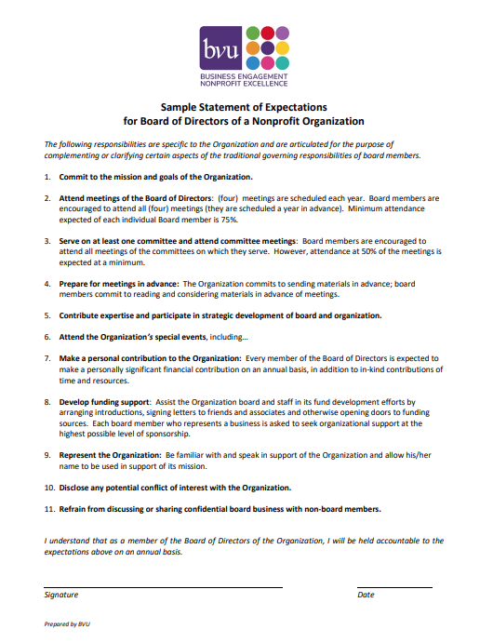

Slide 20
3
Build constructive partnership with the CEO
Annual compensation and evaluation process – 80%
Open and honest communication
Annual one-on-one meeting
4
Structure effective meetings
Set dates early; begin and end ON TIME
Engaged board members do their HOMEWORK BEFORE board meetings
Board portal
Consent agenda – 57%
Dashboard report – 44%
Executive Session – 61%

Slide 21
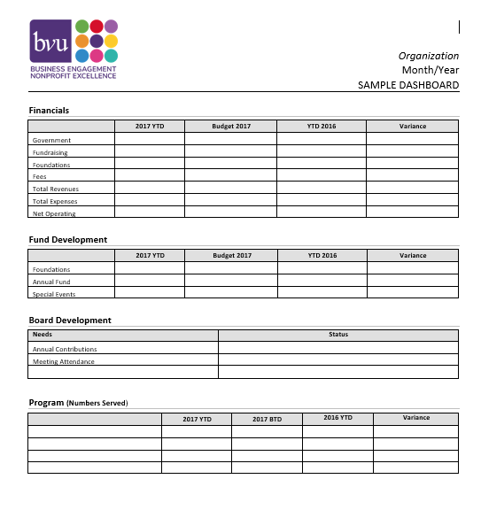

Slide 22
5
Ensure relevant board and committee structure
Average number of committees – 4.8
Average number of board meetings – 6
Executive Committee – 78%
Average board tenure – 6 years (2 three-year terms)
6
Seek competent and diverse board composition
Average board size – 15 members
Race/ethnicity – 84% Caucasian
Age – 17% under 40 years old

Slide 23
Why is Diversity Important in the Nonprofit Board Room?
Better decision- making​
More responsive ​
Stronger access
Better pipeline​
Mission alignment​
Diverse perspectives are better qualified to identify the full range of risk and opportunity​
Diverse boards reflect the communities they serve, which improves the ability to comprehend and respond to environmental and external changes and trends​
To resources that are important to achieving the mission​ diverse connections with policy makers, donors and collaborative partners​
Boards that are not diverse risk becoming stagnant​
Diversity is part of the organization’s mission and essential to develop and deliver programs that support the mission​
*excerpt from BoardSource’s Board Governance Index: Is Your Board “Normal”?, ​ (by Ruth McCambridge, January 2015​)

Slide 24
7
Effective communication and deliberation
Create culture of trust, transparency and inquiry
Ensure that board functions in all three modes:
Fiduciary: Legal responsibility for oversight and stewardship
Strategic: Ensure a winning strategy; decisions about resources and programs
Generative: Serve as source of leadership & deeper inquiry; explore root causes, values, optional courses and new ideas
8
Succession plan for the chief executive and the board chair
34% have a written CEO Succession Plan
Qualities to seek in a board chair:
Ability to build constructive partnership with CEO
Fosters trust
Resolves conflicts, builds consensus
Frames and discusses strategic questions
Establishes clear expectations for board members

Slide 25
“
Board members should not feel like “docile mushrooms (warm and in the dark).”
“
McFarlan and Epstein
Nonprofit Boards: A Guide, 2009

Slide 26
Resources for Board Members
Business Volunteers Unlimited (BVU)
BoardSource
Independent Sector
Nonprofit Finance Fund
www.boardsource.org
www.independentsector.org
nonprofitfinancefund.org
www.bvuvolunteers.org

Slide 27
Sample Question to Explore Board Opportunity
Meeting with the chief executive and board chair to discuss:

Mission and scope of programs

Revenue structure and key funding sources

Key challenges facing the organization in next 3 years

Key opportunities for organization growth

Strategic plan

Relationship between chief executive and board

Role of the board

Expectations of individual board members ($, time, events)

D&O insurance

Tour of facilities

Slide 28
Thank you
BVU connects businesses and nonprofits, creating connections to better our community.
@bvuvolunteers
linkedin.com/company/bvu
facebook.com/bvuvolunteers
flickr.com/photos/bvu

Slide 29
Board of Directors: Governance and Leadership
Leslie M. Connolly, Esq.
Joseph G. Casion, Esq.
Harter Secrest & Emery LLP
8 Denison Parkway
Corning, NY 14830
(585) 232-6500

Slide 30
General Concept
Generally, the Board exercises its legal governance responsibilities by
Supporting the Organization by providing resources to further the mission of the Organization; and
Monitoring and evaluating the overall performance of the Executive Director and the Organization.

Slide 31
What Board “Governance” Means
This involves:
Working with management to establish strategic direction and carry out objectives
Ensuring that resources are available and assets are properly managed
Ensuring that the Organization operates responsibly and effectively
Monitoring the Board’s performance and ensuring Board continuity
Advising, evaluating and supporting the Chairperson and the Executive Director
Acting as an ambassador and advocating for the Organization

Slide 32
Division of Responsibilities
Items appropriate for Board review and approval:
Mission
Governance Policies and Procedures
Regulatory Reporting
Organizational Finances and Audits
Major Corporate Transactions
Chief Executive Officer
All remaining items should be undertaken by the Executive Director and Staff.

Slide 33
Examples
Mission
Adopting the strategic plan and long-term goals for the Organization; approving changes in the charitable mission; approving substantial changes to the scope of services provided or geographic area served by the Organization
Governance Policies and Procedures
Adopting and amending the Organization’s bylaws, policies, procedures and charters as necessary and as required by law; reviewing and approving recommendations from committees without delegated authority
Committee actions shall be regularly reported to the Board even if Board approval is not required

Slide 34
Examples (cont’d)
Regulatory Reporting
Audits or assessments by state or federal authorities (e.g., DOH, CMS, IRS) that have primary regulatory oversight over the programs, services and finances of the Organization
Organizational Finances and Audits
Approving the annual budget prepared by management and/or appropriate committee; authorizing “material” changes to the approved budget; approving engagement of auditors and accepting audited financial reports

Slide 35
Examples (cont’d)
Major Corporate Transactions
Approving the sale or purchase of assets, mergers, dissolution or lease of real property (by or of the Organization) if such transaction would constitute substantially all assets of the Organization; changes in corporate structure (e.g., the formation of a “holding company” or affiliate)
Chief Executive Officer
Hiring, terminating and evaluating performance and setting compensation for the CEO

Slide 36
Board Fiduciary Duties
Three Duties:
Duty of Care
Duty of Loyalty
Duty of Obedience

Slide 37
Duty of Care
A Director shall discharge the position in good faith and with a degree of diligence, care and skill that an ordinarily prudent person would exercise under similar circumstances in a like position.
The duty of care consists of both a duty of attention and a duty of informed decision-making. Some decision responsibility can be delegated to committees, advisors and staff.
Duty of attention shifts to duty of “supervision” when decision-making is delegated.

Slide 38
Duty of Loyalty
A Director shall have an undivided allegiance to the organization and shall not use his or her position to improperly benefit from or gain an advantage that properly belongs to the organization.
The duty of loyalty encompasses a prohibition against private gain and a prohibition against (unreviewed and unapproved) transactions involving conflicts of interest.
Disclose, Discuss and Document.

Slide 39
Duty of Obedience
A Director shall carry out the organization’s mission as defined in its governing documents and ensure that it complies with applicable laws.
The duty of obedience requires that the organization’s assets be used and deployed in furtherance of the organization’s purposes and in compliance with law.

Slide 40
Other Noteworthy Items
Volunteer Immunity
D&O Insurance

Slide 41
Questions?

Slide 44
About NYCON & Our Corporate Family
NYCON
State association in NYS with 3,000 members
Provide a wide range of TA /Training services, group business products & services, information, state & federal advocacy, etc.
Innovative Charitable Initiatives (ICI)
Fiscal agent/ incubation services for emerging nonprofits or divested programs
Employment administration
Services available nationally
Board Strong
Board matching tool (online www.boardstrong.org)
Council Services Plus (CS Plus)
Social enterprise insurance brokerage firm (employee benefits and liability insurance)
Risk management consultation

Slide 45
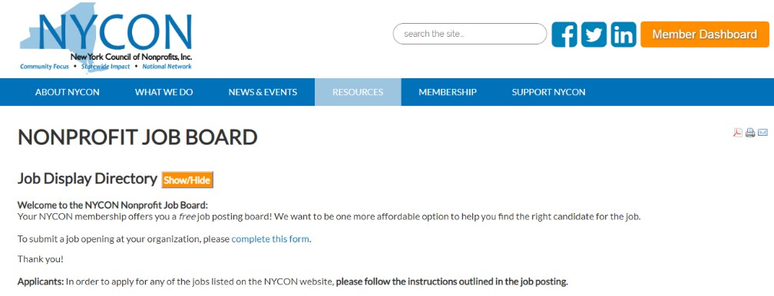
•
•
•
•
•
•
•
•
•
•
•

Slide 46
NYCON TA Services Offered
Board Training
Board and/or Staff
Team Facilitations
Bylaws Amendments
COVID-19 Re-opening
Consultations
Diversity, Equity, & Inclusion Self- Assessment
Federal COVID Loans & Grants (CARES Act and Heroes/Heal Acts)
Financial Infrastructure Assessment
Financial Reporting, Cost-Accounting, Cash Flow Analysis, Etc.
Human Resources
Fund Development Planning
Organizational Assessment
Partnerships, Mergers & Acquisitions
Policy Development (Personnel, Financial, Risk Management, Confidentiality, Conflict of Interest, Etc.)
Strategic Directions/Planning

Slide 47
•
•
•
•
•
•
•
•
•
•

Slide 48
A New Board Matching Platform and Education Website

Slide 49
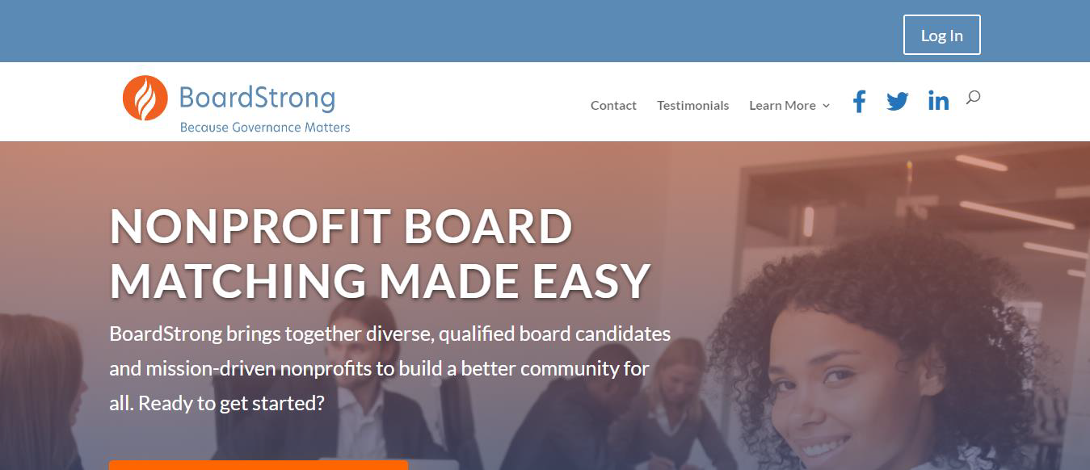
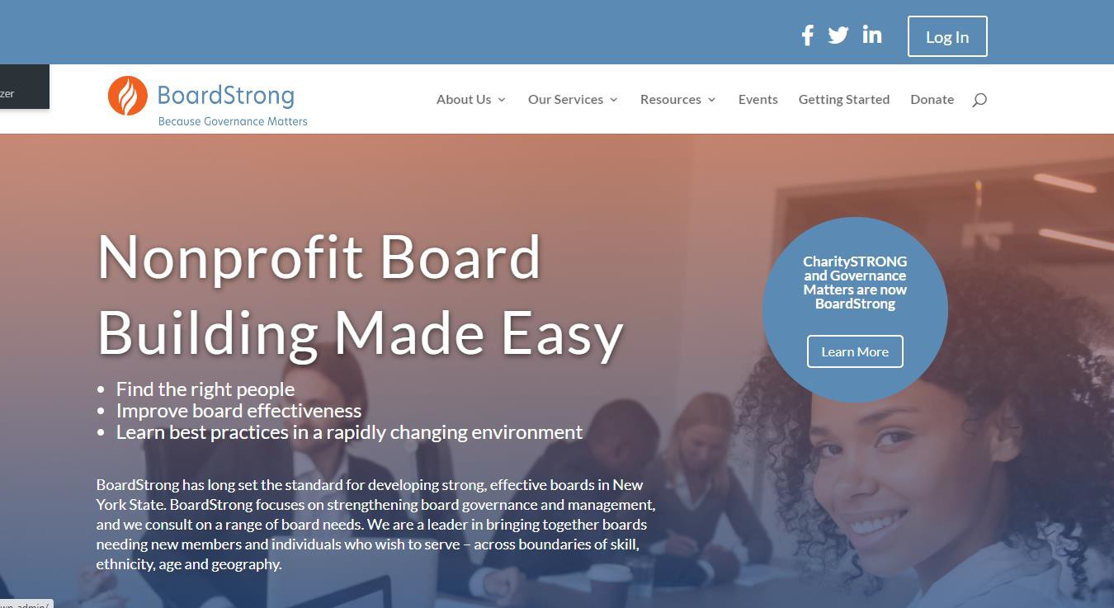
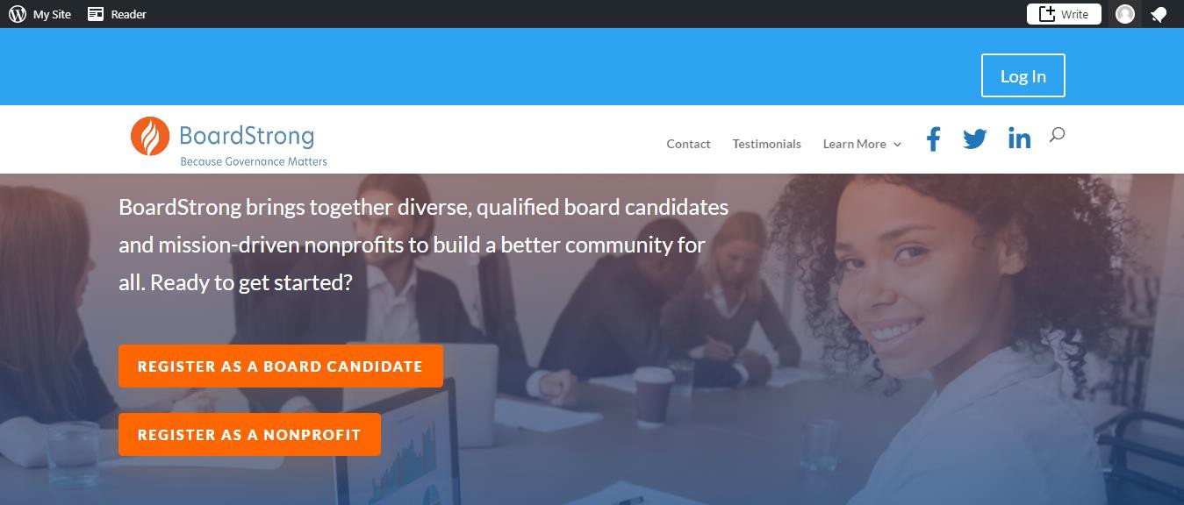

Slide 50
BoardStrong Matching Community Overview
PAGES FEATURED:
Registration
Home
Candidate Profile (captures County location)
Candidate Bank
Board Postings (searchable by County)
Matches

Slide 51
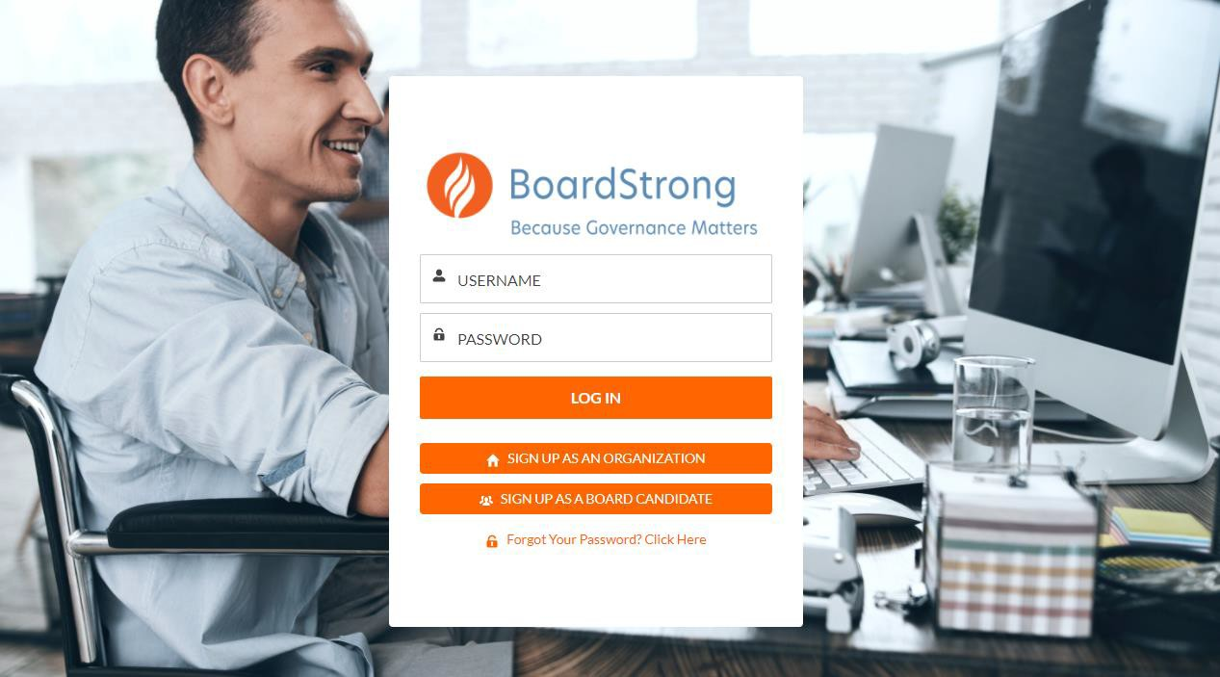
Registration:

Slide 52
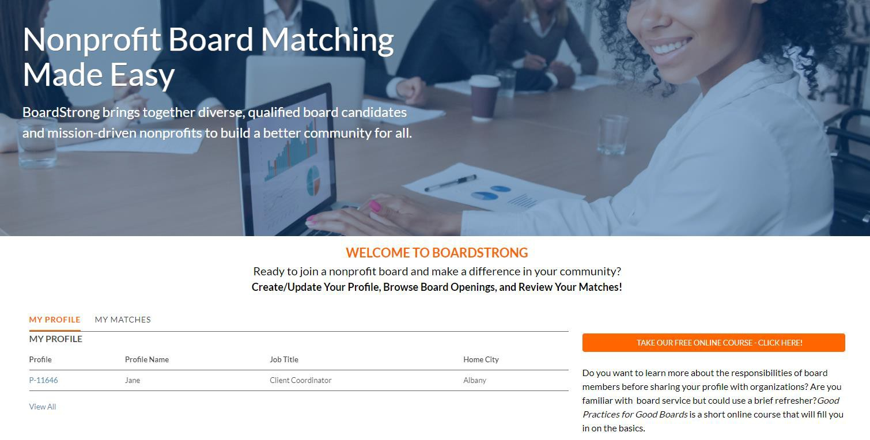
Homepage:

Slide 53
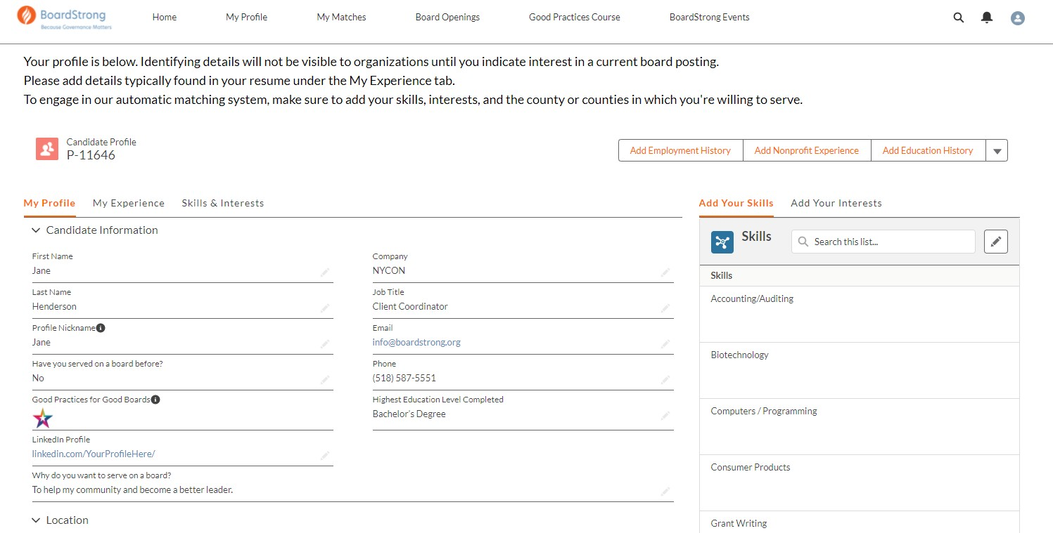
Candidate Profile:

Slide 54
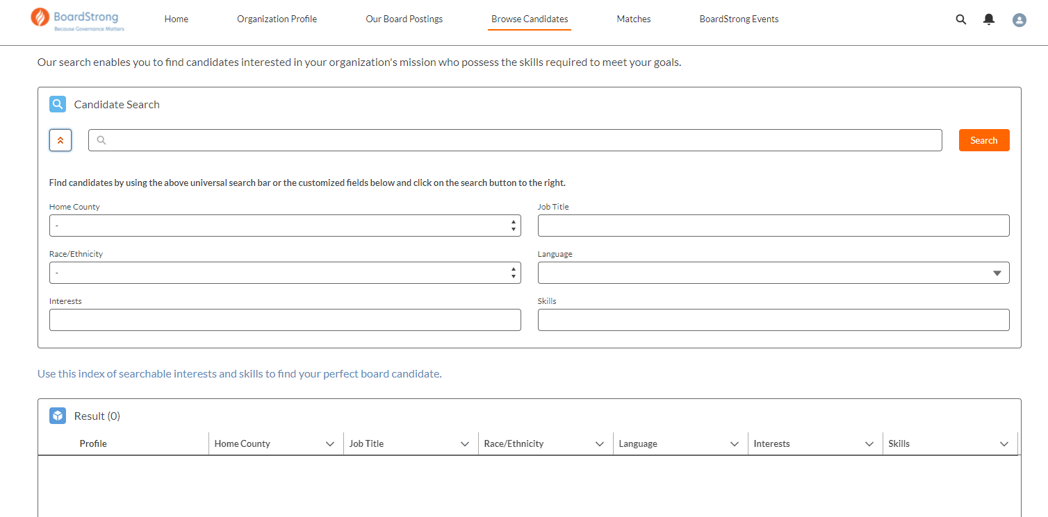
Candidate Search:

Slide 55
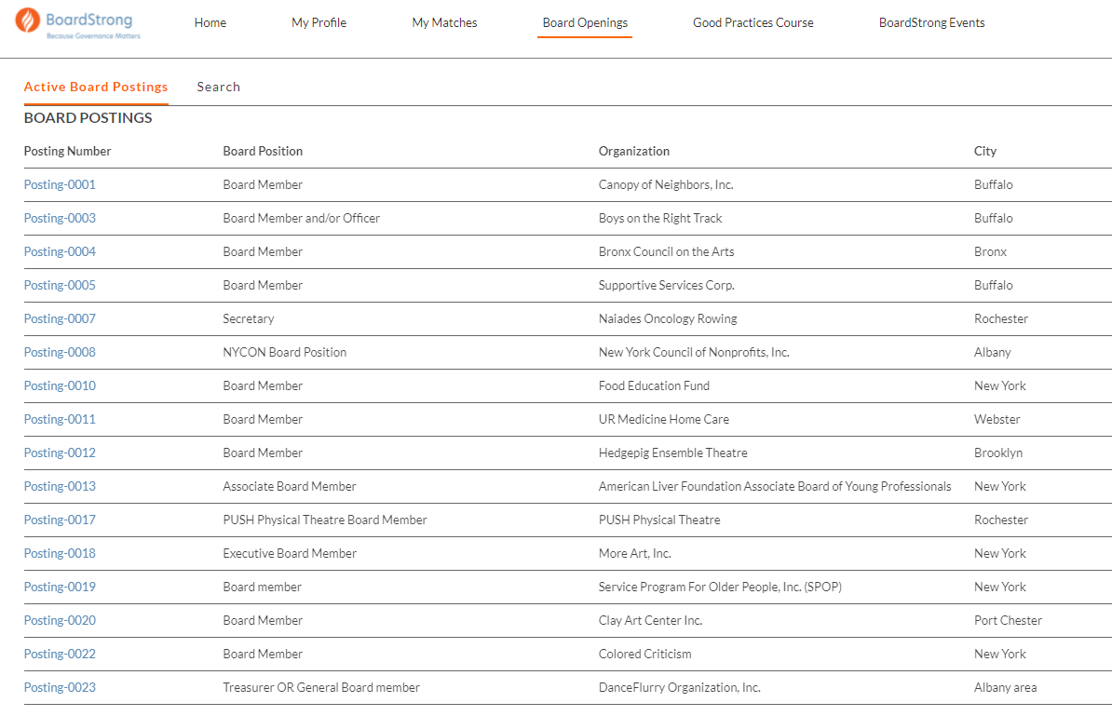
Board openings:

Slide 56
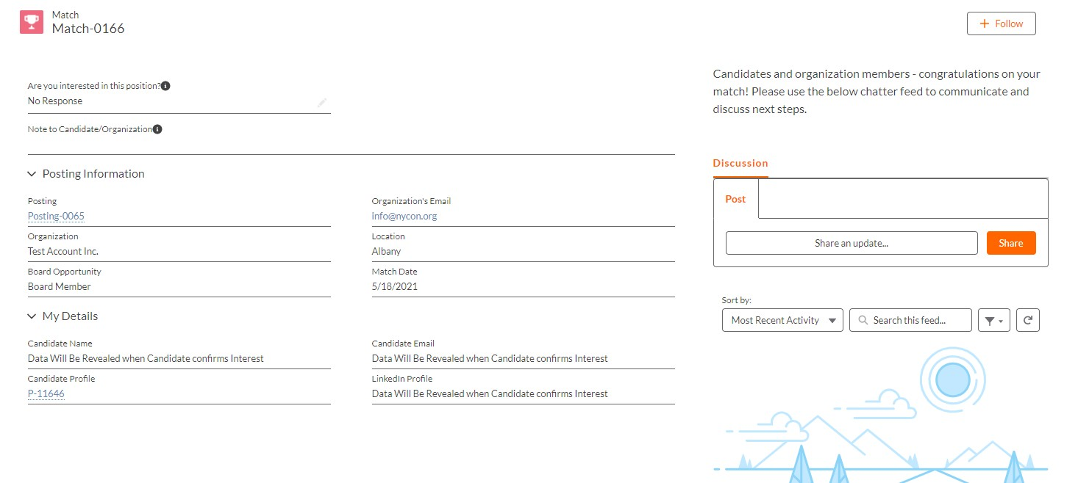
Matches can be made one of three ways:
An organization posts a board opening, then searches the candidate bank and reaches out to candidates
Candidates view board openings and click “I’m Interested” button
The BoardStrong matching system selects candidates with similar interests/skills to the needs of the organization
Users with matches will receive a notification email in their inbox.

Slide 57
Connect With Those Who Care About Your Cause: Start Today
Website: Showcase your board, promote openings and invite inquiries. Offer an online application.
Professional Networks (LinkedIn): Let your contacts know that your organization is
searching. Utilize LinkedIn to recruit.
Web Resources: Go to where the people are. Share, post and promote your board openings on Board Strong.
E-mail: Use your email newsletter to send a message to your contacts about a board
opening.
Social Networking: Highlight your board and why they serve; share, post and promote board opportunities.

Slide 58
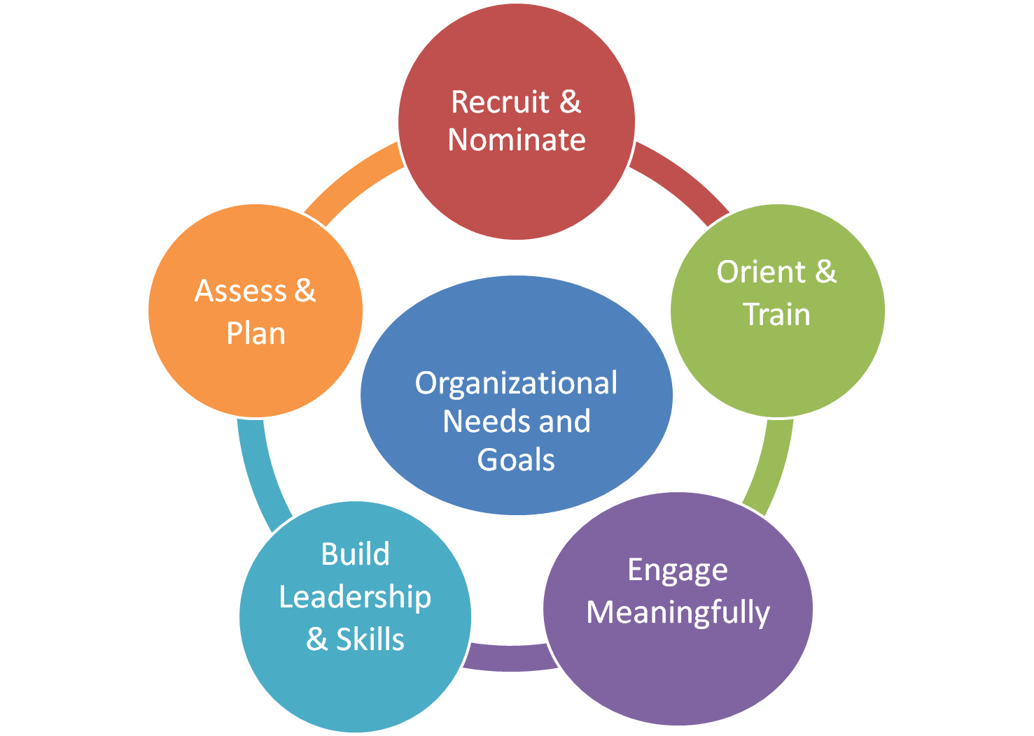
Connection Made…Now What?
Be ready to review applicants and implement your board development process.
Prompt and timely communication is key to success.
Cultivate your new connections and
prepare to onboard them.
Invest in board development.

Slide 59
Questions?
View our tutorial videos at boardstrong.org/getting-started/
FAQ: boardstrong.org/frequently-asked-questions/ More help: info@boardstrong.org

Slide 60
CONTACT INFORMATION
LESLIE M. CONNOLLY Partner Harter Secrest & Emery LLP lconnolly@hselaw.com
ANDREA H. LYNCH Executive Director Corning Incorporated Foundation LynchAH@Corning.com
ANDREW MARIETTA VP, Regional Development New York Council of Nonprofits, Inc. amarietta@nycon.org
ELIZABETH VOUDORIS President & CEO Business Volunteers Unlimited (BVU) evoudouris@bvuvolunteers.org

Slide 61
Thank you
BVU connects businesses and nonprofits, creating connections to better our community.
@bvuvolunteers
linkedin.com/company/bvu
facebook.com/bvuvolunteers
flickr.com/photos/bvu

