Slide 1
Culture: The Story of KPMG
Business Volunteers Unlimited
Annual Summit – May 2021

Slide 2
Culture: What, Why, and How
8:15 – 8:45 am
Our Session
Breakout Session
8:45 – 9:05 am

Slide 3
What is
Culture is how we do things around here.
It’s the worst behavior we tolerate.
It is everyone’s responsibility.
culture?

Slide 4
How intentionally are you shaping?
What is
Signals/Symbols of Desired Culture
“Hard stuff”
Indicators/Drivers of Actual Culture
“Soft stuff”
culture?
Culture
Purpose & Values
Mindsets
Codes / Policies, SOPs
Behaviors
Systems
Informal Norms

Slide 5
92% of CEOs and CFOs believe that by improving their culture they would improve company’s value; only 15% believe their culture is where it should be.
Columbia School of Business and Duke’s Fuqua School of Business joint study of over 1,400 North American CEOs and CFOs

Slide 6
We ARE one of those companies…
Here’s our story.

Slide 7
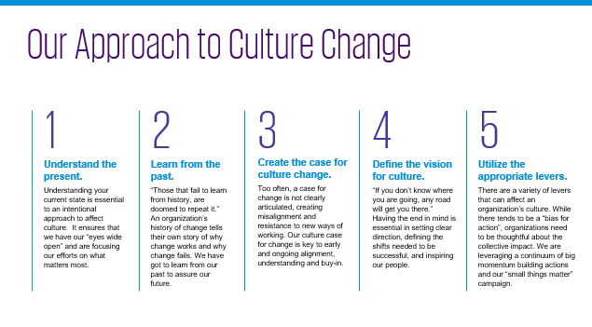
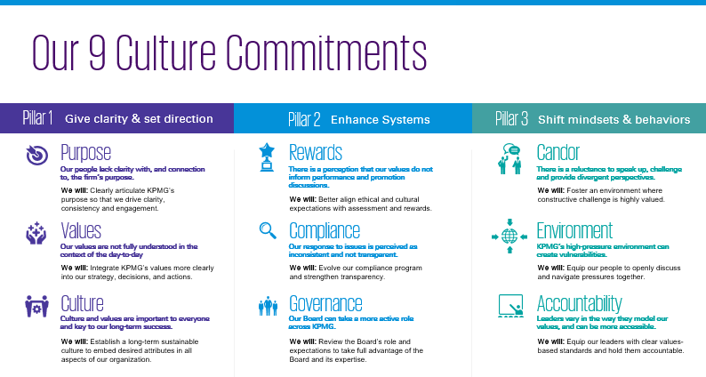
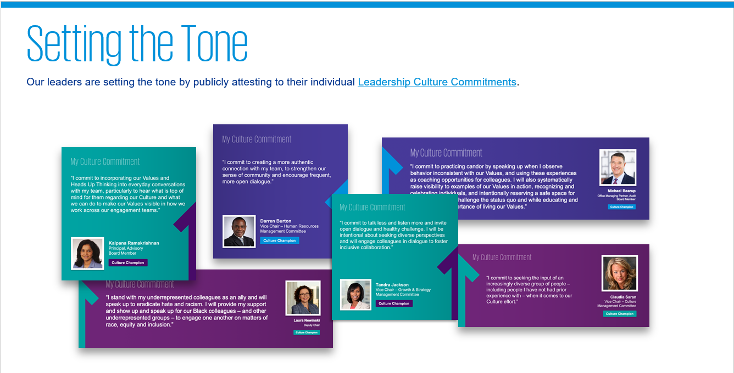
Our KPMG Culture Journey
Our Initial Approach to Culture Change
Our Scope: 9 Culture Commitments
Our New Foundation: Refreshed Values & Vision
From Words to Action: Setting the Tone
Understanding Pressures: Enabling our People
Our Culture Measurement Approach
7

Slide 8
Our Values@Work...@Home – our pivot
March
April
May
June
July
August
September
Integrity
Values/HUT
For Better
Together
Courage
Excellence
Given COVID–19, pivot to add the … @Home element
Restart of Deep Dives (Reverse Order)

Slide 9
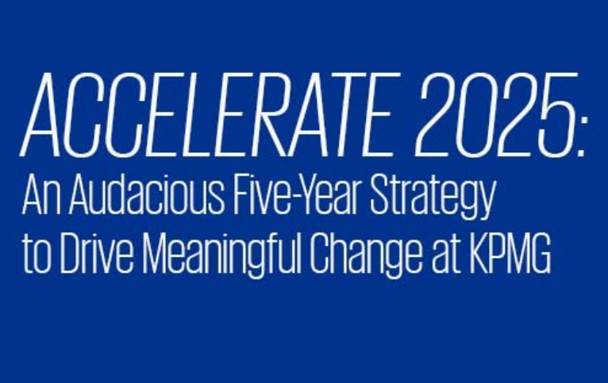
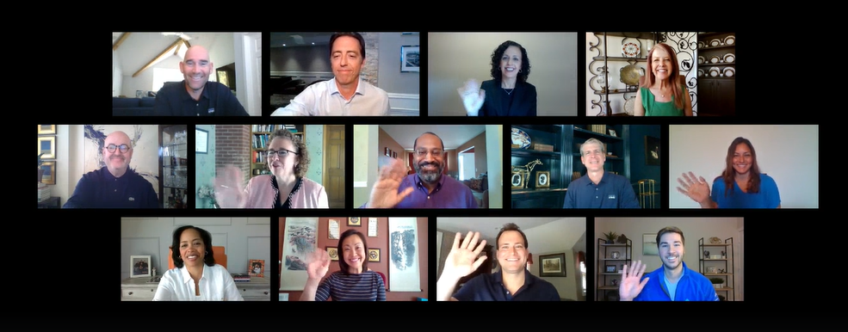
Our pivot (continued)
Bold New Commitments -
Reinforcing Our Values
Doubling Down on Resiliency &
Employee Experience
Leaning into Our Values@Home
9

Slide 10
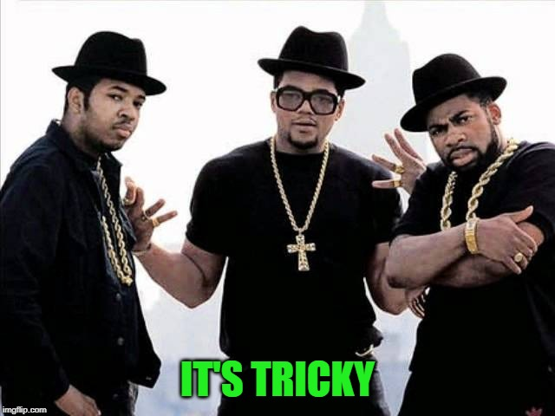
Why do companies struggle?
On average, 69% of employees don’t believe in the cultural goals set by their leaders; 87% don’t understand them, and 90% don’t behave in ways that align with them*. But why?
*Large scale study conducted by Gartner, involving thousands of employees and HR leaders globally (surveying over 7500 employees and 200 HR leaders, with in depth interview of over 100 HR leaders of global companies)

Slide 11
Drivers of Culture
Clarity
Reward &
Enforce
Detection
Role Modelling
Speak‑up
Commitment & Engagement
Behavior
Ability to Discuss
Enabling Environment
Information Flow
KPMG Proprietary Model

Slide 12
Levers of Change
30%
Change efforts fail without good change leadership. Leaders need to give clarity, set direction and build belief through their words and actions.
70%
Of Impact:
Organizational Levers
Shift Mindsets
& Behaviors
Enhance Systems
Controls & Governance
Physical Environment
Tools & Technology
Budgeting & Forecasting
Resource Allocation
Recruitment & Onboarding
Rewards & Recognition
People Development
Performance Evaluation
Succession Planning
Misconduct Reporting & Investigations
Sanctions
Termination / Exit Process
Business Due Diligence and Integrations
Execution is only as good as the leaders that drive it
Of Impact:
Change Leadership Levers
Clarity of Expectations
Role Modelling
Leadership Commitment / Symbols
Accountability (Self and Others)
Information Flow / Communication
Support & Enablement
Consistency
© 2021 KPMG LLP, a Delaware limited liability partnership and the U.S. member firm of the KPMG network of independent member firms affiliated with KPMG International Cooperative (“KPMG International”), a Swiss entity. All rights reserved. NDP118740

Slide 13
Adversity does not build character
…it reveals it
James Lane Allen

Slide 14
Elevated Risk:
Many are finding it difficult to adjust to the new normal and deal with uncertainties.
41%
Say their happiness at work has worsened
Source: KPMG 2020 American Worker Pulse Survey

Slide 15
What you can do today
Set the foundation
Be intentional
Know what you stand for
Give permissions
Start doing now!
Acknowledge the say / do gap
Celebrate the good – recognize meaningfully, visibly, and FREQUENTLY
Support your colleagues, check-in, show compassion
Be an upstander – nudge others in the right direction
Tell stories!

Slide 16
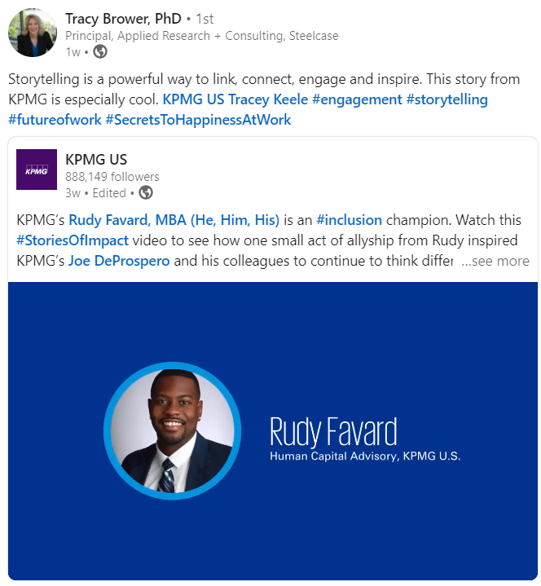
Cultural Proof Points
+400 Stories of Impact and counting!
Learn More About KPMG's Culture and Values

Slide 17
Culture Resources
KPMG Resources
Five Steps to Tackling Culture
Leveraging Internal Audit to Understand Culture
Culture: An Organizational Antidote for COVID-19
COVID-19 and the American Worker
Understanding the People Impacts of COVID-19
Redefining Culture for Now Digital Workforce
Other Culture Reads and Recommended Resources
Edelman Trust Barometer
NACD Culture as a Corporate Asset
The 10 Laws of Trust
Radical Candor

Slide 18
Thank you!

Slide 19
Some or all of the services described herein may not be permissible for KPMG audit clients and their affiliates or related entities.
kpmg.com/socialmedia
The information contained herein is of a general nature and is not intended to address the circumstances of any particular individual or entity. Although we endeavor to provide accurate and timely information, there can be no guarantee that such information is accurate as of the date it is received or that it will continue to be accurate in the future. No one should act upon such information without appropriate professional advice after a thorough examination of the particular situation.
© 2021 KPMG LLP, a Delaware limited liability partnership and the U.S. member firm of the KPMG network of independent member firms affiliated with KPMG International Cooperative (“KPMG International”), a Swiss entity. All rights reserved. NDP118740
The KPMG name and logo are registered trademarks or trademarks of KPMG International.

