Slide 1
Minority Pipeline Initiative: Role of the Board To train, match, and elect professionals of color to nonprofit boards of directors
PRESENTED BY: Business Volunteers Unlimited
April 21, 2021

Slide 2
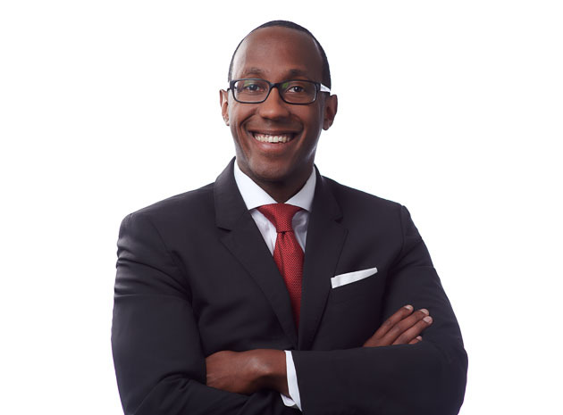
Welcome
Michael Bowen Calfee

Slide 3
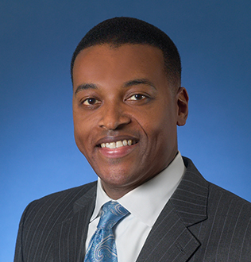
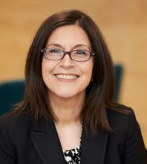
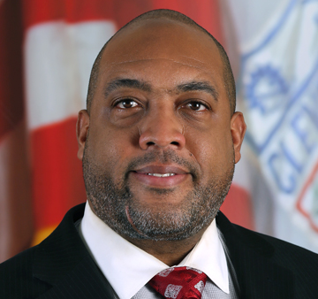
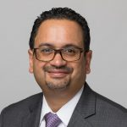
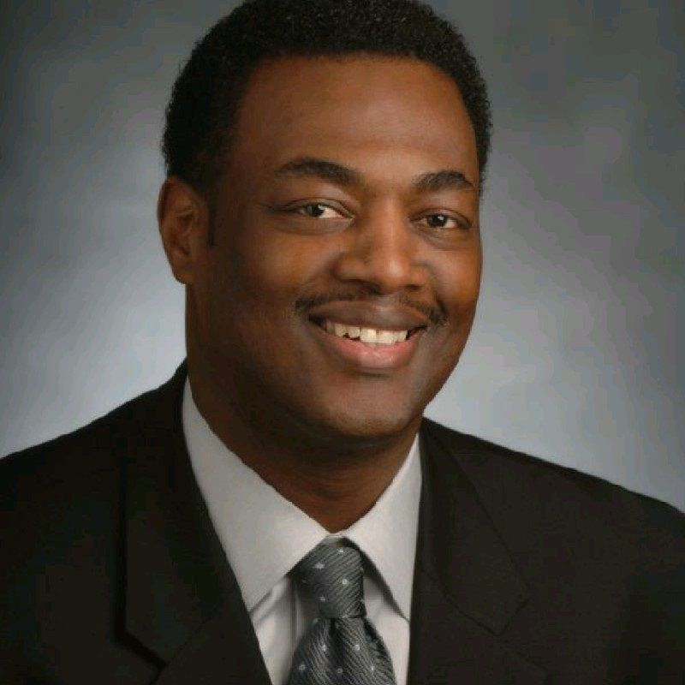
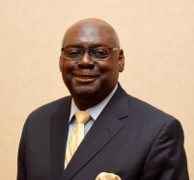
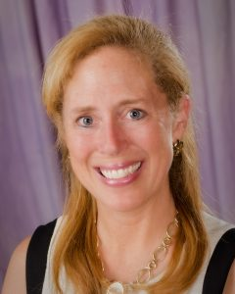
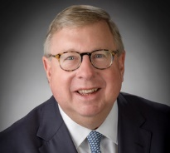
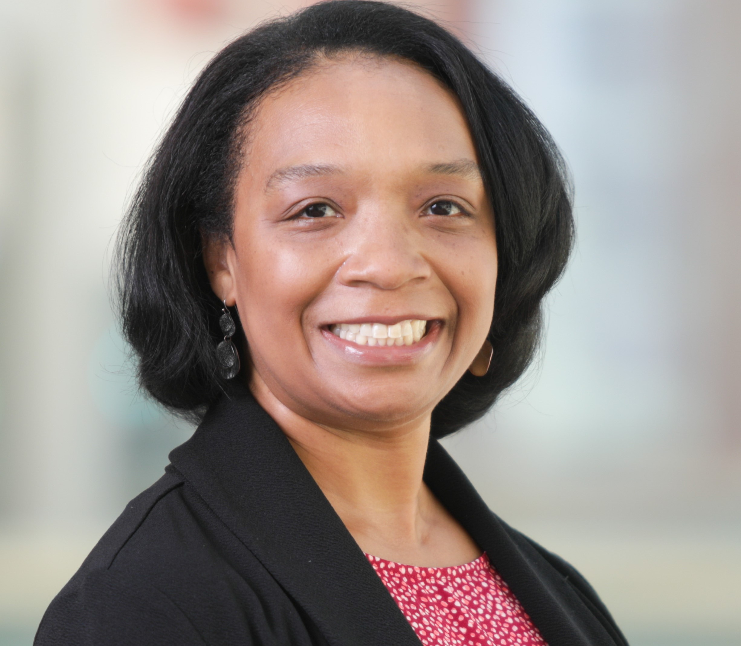
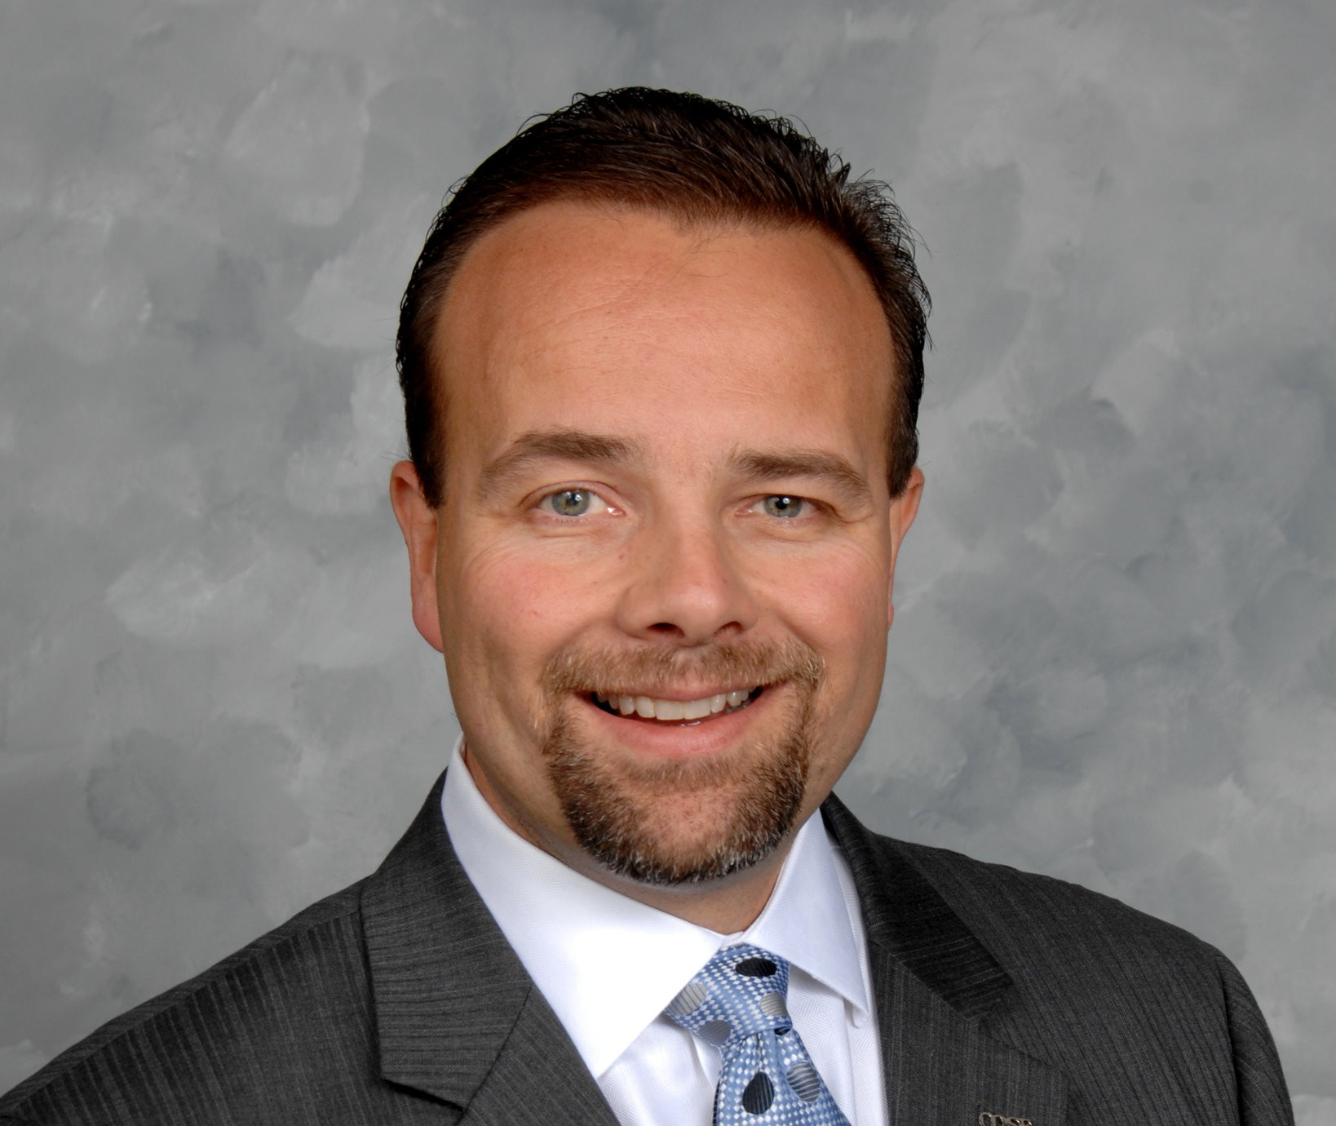
Minority Pipeline Initiative Task Force
Randell McShepard
RPM International, Inc.
Chairman
April Miller Boise
Eaton
Michael Bowen
Calfee
Gregory Brown
PolicyBridge
Paul Clark
PNC (retired)
Nicole Crews
Swagelok
Lauren Gliha
BVU
Blaine Griffin
Cleveland City Council
Vaughn P. Johnson
Urban League of Greater Cleveland
Allison Kimbrough
BVU
Steve Millard
Greater Akron Chamber
Dr. Charles Modlin
Cleveland Clinic
Marcia Moreno
Young Latino Network
Victor Ruiz
Esperanza, Inc.
Sharon Sobol Jordan
Unify Labs
Elizabeth Voudouris
BVU
Michael White
Jack, Joseph and Morton Mandel Foundation

Slide 4
AGENDA:
Welcome​
Housekeeping ​
Breakout Introduction Groups​
The Role of the Board: An Overview​
Panel: The Role of the Board​
Call to Action​
Closing

Slide 5
Breakout Introduction Groups

Slide 6
The Role of the Board: An Overview
Elizabeth Voudouris
BVU

Slide 7
Context: DE&I on Nonprofit Boards
1

Slide 8
National Nonprofit Board Demographics*
 | Board Members | Board Chair | Chief Executive | Notes
People of color | 16% | 10% | 11% | On boards, people of color increased from 16% in 2010 to 20% in 2015.
White | 84% | 90% | 90%
Are you satisfied with your board’s level of racial/ethnic diversity? |  | 31% YES | 18% YES | Board chair’s satisfaction was 55% in 2015. Chief executive’s satisfaction decreased from 31% in 2015.
Does your board represent the demographics of the population served by your organization? |  | 71% NO | 62% NO
Is expanding the board’s racial and ethnic diversity important to increasing your organization’s ability to advance its mission? |  |  | 62% YES
*from Leading with Intent, A National Index of Nonprofit Board Practices, January 2017

Slide 9
BVU's Nonprofit Stability Index - July 2020 & January 2021

Slide 10
BVU Minority Pipeline Initiative
Demand
488 requests from 338 different nonprofits
Supply
From 2014-2019 BVU facilitated 1,000 elections to nonprofit boards
160 people of color (15%)

Slide 11
BVU| Minority Pipeline Initiative UPDATE
Training Delivered
100 potential board candidates
270 nonprofit reps
Board Matching Results
Call to Action
MPI Role of the Board- October 2020
Potential board candidates
100 attendees
Operationalizing DEI – October 2020
Nonprofit senior staff
170 attendees
Inclusion in the Board Room – February 2021
Nonprofit senior staff
100 attendees
26 Meet-a-match sessions
13 elections
13 Pending referrals
Overall board matching diversity 28% YTD
Increase registration: April 21st Role of the Board, 5pm, Zoom
Initial Invites sent to:
Global Cleveland, Black MBAs, BPCAF, GCP, Urban League, Akron Chamber, YLN, Cleveland City Council, Esperanza, BVU business partners, past participants
Where else?
Volunteer to facilitate breakout group

Slide 12
Sector Trends
2

Slide 13
Nonprofits Faced a Confluence of Challenges in 2020
COVID-19/Shelter in Place Order
Economic Downturn
Racial Justice

Slide 14
1
Proliferation of Nonprofit Organizations
Over 1.3 million active nonprofit organizations
Provide 11.4 million jobs
5.4% of GDP ($887 billion to US economy)
Nonprofits in Ohio: 40,521
3rd largest industry employer in the state
Nonprofits by county:
Cuyahoga | 15,599
Summit | 4,640
Lorain | 2,037
Lake | 1,591

Slide 15
State of the Sector in Ohio
Ohio’s Attorney General and
Philanthropy Ohio conducted a 2nd statewide survey in August 2020
BVU conducted a 3rd survey of nonprofits in NEO in January 2021
Ohio NPO COVID-19 Survey STATS:
61% operate at moderately or severely reduced capacity
2/3 deliver services differently
14% cut or furloughed staff
86% saw decrease in earned revenue
50% saw decrease in donated revenues
15% of board seats filled with people of color
BVU NONPROFIT STABLITY INDEX:
58% will make long-term changes to how they deliver services
89% are able to deliver services through virtual platforms
54% cut or furloughed staff (July survey)
92% reported that COVID has had a negative impact on revenue streams
71% saw decline in earned revenue
84% saw decline in event revenue
71% are dissatisfied with the diversity of their Board of Directors

Slide 16
3
Strategic and Financial Pressures
Increasing demand
Shrinking resources
Reduction in government funding
501-C3 “nonprofit” is tax status, not business model

Slide 17
Financial Models
FOR PROFIT:
Customer buys product
NONPROFIT:
Client pays partial or nothing
Price includes cost of doing business
Overhead and profits seen as necessary
Success=financial results
Rely on 3rd party to cover cost (donors and funders)
Overhead and profits seen as unrelated to achieving mission
Success=mission impact
On average, successful for-profit companies allocate 25% of budget to overhead.*

Slide 18
4
Strategic Alliances
Economies of scale
Avoid duplication
Sustainability
68% collaborate to provide programs
5
Increased Scrutiny and Transparency
Outcome metrics
990
Executive Compensation

Slide 19
Funding Trends - Charitable contributions are significant source of revenue
Total 2019 contributions: $449.64 billion
5%
2%
4%
6%
10%
28%
17%
9%
69%
12%
14%
12.5%
19
2019 contributions by source (by percentage of the total)
2019 contributions by recipient organization (by percentage of the total)

Slide 20
6
2020 Giving Trends
$15.5% Billion awarded to COVID in USA
44% from corporations
35% of Covid Philanthropy went to BIPOC community
2020 was a catalyst for donor generosity – avg DAF donations up 20% (Fidelity)
Overall donations to charity up 2% in 2020
Online giving increased by 21%

Slide 21
The Role of the Board of Directors
3

Slide 22
Authority
The board of directors bears the primary responsibility for ensuring that a charitable organization fulfills its obligations to the law, its donors, its staff and volunteers, its clients, and the public at large.
Basic authority (§1702.30(A), O.R.C.):
“all of the authority of a corporation shall be exercised by or under the direction of its directors.”

Slide 23
The Board Functions as a Team
The role of the board refers to the board as a whole, a unit, a team. Individual board members do not have authority or individual rights
Accountability and responsibility rests with the full board…
Not the Chair
Not the CEO
Not individual board members

Slide 24
1
Determine mission, vision and strategic direction
Scan internal and external environment
Review and modify strategic plan
Monitor performance based on key milestones and success factors
2
Establish and strengthen community relations
Ambassadors
Talking points
Crisis/transition communications strategy

Slide 25
3
Select and support the chief executive
Partnership
CEO performance evaluation and process to set compensation (990 requirement)
Succession plan
Open doors
4
Develop funding resources
Individual, annual, financial contribution
Donor identification
Donor cultivation

Slide 26
5
Provide financial oversight
Adequate accounting skills
Annual budget
Regular financial statements and cash flow reports
Annual audit
Investment policies
6
Ensure legal and ethical integrity
Duties of care, loyalty and obedience
Board has the authority as a group, not as individual members
96% of nonprofits carry Directors and Officers Liability Insurance for their boards

Slide 27
7
Develop the board
Governance Committee
Adopt best practices
Review and update bylaws periodically

Slide 28
There Is a Great Difference Between Sitting on a Board and Serving on a Board.

Slide 29
Best Practices of Governance
4

Slide 30
1
Define the unique “work” of your board
Lifecycle of nonprofit
2
Strengthen board member engagement
Clarify expectations and accountability (81% have written job descriptions for board members; 52% conduct annual assessment)*
Orientation
Engage new board members on at least one committee right away
Buddy system
*excerpt from BoardSource’s Leading with Intent.
(2019)

Slide 31
3
Build constructive partnership with the CEO
Annual compensation and evaluation process – 80%
Open and honest communication
Annual one-on-one meeting
4
Structure effective meetings
Set dates early; begin and end ON TIME
Engaged board members do their HOMEWORK BEFORE board meetings
Board portal
Consent agenda – 57%
Dashboard report – 44%
Executive Session – 61%

Slide 32
5
Ensure relevant board and committee structure
Average number of committees – 4.8
Average number of board meetings – 6
Executive Committee – 78%
Average board tenure – 6 years (2 three-year terms)
6
Seek competent and diverse board composition
Average board size – 15 members
Race/ethnicity – 84% Caucasian
Age – 17% under 40 years old

Slide 33
Why is Diversity Important in the Nonprofit Board Room?
Better decision- making​
More responsive ​
Stronger access
Better pipeline​
Mission alignment​
Diverse perspectives are better qualified to identify the full range of risk and opportunity​
Diverse boards reflect the communities they serve, which improves the ability to comprehend and respond to environmental and external changes and trends​
To resources that are important to achieving the mission​ diverse connections with policy makers, donors and collaborative partners​
Boards that are not diverse risk becoming stagnant​
Diversity is part of the organization’s mission and essential to develop and deliver programs that support the mission​
*excerpt from BoardSource’s Board Governance Index: Is Your Board “Normal”?, ​ (by Ruth McCambridge, January 2015​)

Slide 34
7
Effective communication and deliberation
Create culture of trust, transparency and inquiry
Ensure that board functions in all three modes:
Fiduciary: Legal responsibility for oversight and stewardship
Strategic: Ensure a winning strategy; decisions about resources and programs
Generative: Serve as source of leadership & deeper inquiry; explore root causes, values, optional courses and new ideas
8
Succession plan for the chief executive and the board chair
34% have a written CEO Succession Plan
Qualities to seek in a board chair:
Ability to build constructive partnership with CEO
Fosters trust
Resolves conflicts, builds consensus
Frames and discusses strategic questions
Establishes clear expectations for board members

Slide 35
“
Board members should not feel like “docile mushrooms (warm and in the dark).”
“
McFarlan and Epstein
Nonprofit Boards: A Guide, 2009

Slide 36
Resources for Board Members
Business Volunteers Unlimited (BVU)
BoardSource
Independent Sector
Nonprofit Finance Fund
www.boardsource.org
www.independentsector.org
nonprofitfinancefund.org
www.bvuvolunteers.org

Slide 37
Sample Question to Explore Board Opportunity
Meeting with the chief executive and board chair to discuss:

Mission and scope of programs

Revenue structure and key funding sources

Key challenges facing the organization in next 3 years

Key opportunities for organization growth

Strategic plan

Relationship between chief executive and board

Role of the board

Expectations of individual board members ($, time, events)

D&O insurance

Tour of facilities

Slide 38
Thank you
BVU connects businesses and nonprofits, creating connections to better our community.
@bvuvolunteers
linkedin.com/company/bvu
facebook.com/bvuvolunteers
flickr.com/photos/bvu

Slide 39
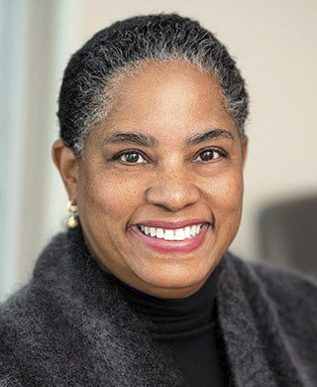
The Fiduciary Duties of Nonprofit Boards
Inajo Davis Chappell
Ulmer & Berne LLP

Slide 40
Duties of Nonprofit Directors
Inajo Davis Chappell, Esq.
Ulmer & Berne LLP
1660 West 2nd Street- Suite 1100
Cleveland, Ohio 44113
(216) 583-7140
(216) 583-7141 (Fax)
April 21, 2021

Slide 42
Statutory Authority of Nonprofit Directors
O.R.C. § 1702.30(A)
“Except where the law, the articles, or the regulations require that action be otherwise authorized or taken, all of the authority of a corporation shall be exercised by or under the direction of its directors.”

Slide 43
Statutory Standard of Care
O.R.C. §1702.30(B)
A director shall perform the duties of a director, including the duties as a member of any committee of the directors upon which the director may serve, in good faith, in a manner the director reasonably believes to be in or not opposed to the best interests of the corporation, and with the care that an ordinarily prudent person in a like position would use under similar circumstances.”

Slide 44
Statutory Standard of Care (cont’d)
A director’s conduct is measured against a very high evidentiary standard.
A director shall not be found to have failed to satisfy his/her duties in accordance with the statute, unless it is proved by clear and convincing evidence that the director has not acted in good faith . . .” in the manner stated in subparagraph (B) above.

Slide 45
Statutory Standard of Care (cont’d)
Subparagraph (D) of the statute provides that a director is liable in damages for any act that the director takes or fails to take as director (only if proved by clear and convincing evidence) that the act or omission of the director was one undertaken i) with a deliberate intent to cause injury to the corporation or ii) with a reckless disregard for the best interests of the corporation.

Slide 46
“Reasonable Belief As To Best Interests of Corporation”
Subparagraph (E) of the statute provides that “ . . . in determining what a director reasonably believes is in the best interests of the corporation, a director shall consider the purposes of the corporation and may consider any of the following:
the interests of the employees, suppliers, creditors, and customers;
the economy of this state and of the nation;
community and societal considerations; and,
the long-term and short-term best interests of the corporation . . .”

Slide 47
Business Judgment Rule
Nonprofit Directors are left solely to their own honest and unselfish judgment.
Courts will not second-guess directors if directors comply with duties of care and loyalty
Process is critical

Slide 48
Duties of Nonprofit Directors
Duty of Care
Duty of Loyalty
Duty to Manage Accounts
Duty of Compliance

Slide 49
Directors Owe Duties to:
Nonprofit Corporation
Public
Creditors (“zone of insolvency”)
Funders

Slide 50
Duty of Care
Regular attendance and participation
Need to be informed
Right to rely on others
Duty of inquiry
Application of considered business judgment

Slide 51
Regular Attendance
Attention
Participation

Slide 52
Need to be Informed
Gather pertinent information
Seek independent advice where necessary
Take appropriate time for study and reflection

Slide 53
Duty of Inquiry
Ask questions
Exercise healthy skepticism

Slide 54
LAWSUITS AGAINST THE BOARD A nonprofit corporation’s board of directors is not a distinct entity from the corporation and is incapable of being sued. Flarey v. Youngstown Osteopathic Hosp., 151 Ohio App.3d 92 (2002).
A nonprofit board of directors is made up of individuals who can be held liable for corporate torts in their individual capacities only if they participated in the tortious conduct.

Slide 55
Permissible Reliance on Others
O.R.C. § 1702.30(B) (Good Faith Reliance Test)
A director is entitled to rely on information, opinions, reports, or statements, including financial statements and other financial data that are prepared or presented by:
Directors, officers, or employees of the corporation as to matters within their areas of knowledge
Counsel, public accountants, or other persons as to matters within their professional or expert competence
Committee of the directors, as to matters within its designated authority
Reasonable belief

Slide 56
Permissible Reliance on Others (cont’d)
A nonprofit director shall not be considered to be acting in good faith if the director has knowledge concerning the matter in question that would cause reliance on information, opinions, reports, or statements to be unwarranted.

Slide 57
Liability of Nonprofit Directors
O.R.C. §1702.55 (A) Members, directors, and officers shall not be personally liable for any obligation of the corporation.
O.R.C. §1702.55(B) Liability for specific acts that violate the NPC Law include a vote for or assent to:
a distribution of assets to members contrary to law or the articles
a distribution of assets to persons other than creditors during the winding up of the affairs of the corporation, on dissolution or otherwise, without the payment of all known obligations of the corporation

Slide 58
Liability of Nonprofit Directors (cont’d)
making of loans, other than in the usual conduct of its affairs to an officer, director or member of the corporation (results in director liability to the corporation )
knowingly receiving any distribution made contrary to law or the articles

Slide 59
Duty of Loyalty
Conflict of interest transactions
Fairness to nonprofit corporation; consistency with organizational mission and purpose
Disclosure and documentation of conflicts

Slide 60
Conflict of Interest Transactions
O.R.C. § 1702.301 Unless otherwise provided in the articles or the regulations:
Transactions between or affecting the corporation and its directors or officers are not void or voidable
Transactions between or affecting the corporation and another entity in which a director or officer has a financial or personal interest are not void or voidable

Slide 61
Conflict of Interest Transactions (cont’d)
Conflict transactions may be approved by a vote including interested directors if:
Material facts are disclosed or known to the directors; and
Authorized by good faith affirmative vote of majority of disinterested directors; or
Transaction approved by directors; or
Transaction is fair to the corporation at the time of its approval

Slide 62
Conflict of Interest Transactions (cont’d)
O.R.C. §1702.301(A)(3)
“The directors, by the affirmative majority vote of a majority of those in office, and irrespective of any financial or personal interest of any of them, shall have authority to establish reasonable compensation, that may include pension, disability, and death benefits, for services to the corporation by directors and officers, or delegate such authority to one or more officers or directors.”

Slide 63
Fairness to the Nonprofit Corporation
Terms at least as favorable to the corporation as might be available from other persons or entities
Reasonable likelihood of furthering the corporation’s mission and purpose
Fair process for approval of the decision

Slide 64
Documentation of Conflicts
Disclosures of conflicts of interest and the results of disinterested directors’ consideration should be documented in the minutes of the meeting
Written policies on conflicts of interest and procedures to monitor compliance with these policies may be appropriate

Slide 65
Nonprofit Directors’ Rights
Directors have a legal right to information and resources needed to perform their duties as directors:
Access to books and records and other data as requested
Inspection of facilities as appropriate
Notice of meetings
Copies of all board meeting minutes

Slide 66
Nonprofit Directors’ Rights (cont’d)
Customary rights of access of directors include:
Access to key executives and other employees, legal counsel, and advisors
Oral or written reports of activities of board committees

Slide 67
Board Governance/Policy Implications
Conflict of Interest Policy-annual reporting of relationships with organization
Code of Ethics-survey or questionnaire for verifying absence of conflicts or disclosure of actual or potential conflicts
Audit Committees - Oversight of the independent auditors by independent and competent board members
Whistleblower Protection –Confidential and anonymous process for reporting complaints, problems or mismanagement without retaliation

Slide 68
High Profile Cases of Self-Dealing and Breach of Fiduciary Duty
Donald J. Trump Foundation
- Lack of Board meetings and oversight for 19 years, misuse of charitable assets, and other violations of law, charitable dollars used for non-exempt purposes
Key Worldwide Foundation –(College Admissions Scandal)
- Activity contrary to stated mission, charitable dollars used to fund for-profit activity, misuse of charitable deductions

Slide 70
Today’s Panel
Victor Ruiz,
Esperanza, Inc.
Randell McShepard
RPM International, Inc.
Inajo Davis Chappell
Ulmer & Berne LLP

Slide 71
How To Get Involved
Lauren Gliha
BVU

Slide 72
Call to Action
Be part of the solution by taking action.
Serving on boards is not just for corporate executives
Boards need diverse voices that are smart, engaged and unabashedly committed to Cleveland and Northeast Ohio

Slide 73
Key Things to Consider
1. Expectations: board & committee meetings| personal contribution & fundraising | multi-year commitment
2. Mission: causes that are meaningful to you personally
3. Skills: how will you make an impact?

Slide 74
Next Steps
Complete the interest form in the chat
2. Complete a short questionnaire – BVU will send this week.
3. Attend “meet-a-match” event and talk with BVU about nonprofits in your interest areas- in May.
4. Meet with on or two organizations. Learn about programs & services and how you can get involved.
5. Share updates with BVU.

Slide 75
Board Service Readiness? YES/NO
I am interested in advancing a cause that I feel excited about.
2. I am curious to learn about issues facing our community.
3. I am interested in learning about leadership in a new environment.
4. I am interested in meeting people outside my usual professional and social circle.
5. I am comfortable making a personal contribution to a nonprofit organization.
6. I can imagine asking others to contribute financially to a cause that I am passionate about.
7. I have enough autonomy in my schedule to accommodate board and committee meetings.
8. I am patient and collegial when working as part of a team.
9. I can commit the time necessary to be an exceptional board member.
*excerpt from BoardSource

Slide 76
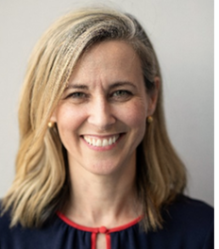
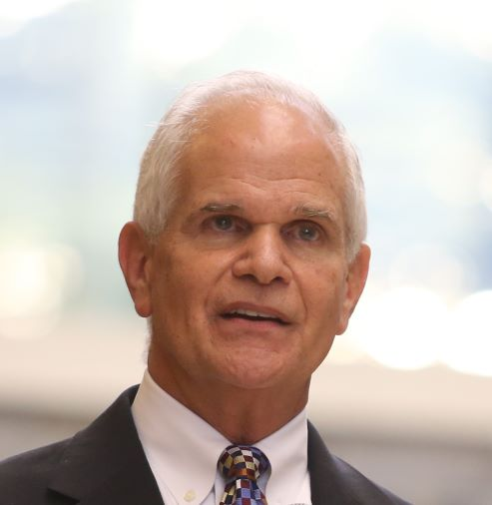
BVU Business Summit May 13, 2021
Join BVU as we explore Corporate Culture, Integrity and Personal Core Values and how community engagement can be leveraged to strengthen culture and employee morale.
Session 1: Corporate Culture – The Story of KPMG
Tracey Keele, KPMG, Culture Co-Lead and Advisory Partner
Session 2: Deeping Your Integrity
John G. Blumberg, CS P, Keynote Concepts, Inc., National Speaker, Author and Thought Leader on Integrity
During this session, we will discuss the story of KPMG and importance of culture as a guiding force in navigating the challenges and opportunities of a COVID / post COVID era. Participants will then have the opportunity to translate learnings into their own context and identify actions they can take back to their own organizations.
In this session, you will discover a refreshing new way to look at the essence of integrity and the pathway to take you to a whole new level of core clarity. Most importantly, you will meet the potential of integrity in a whole new way — more challenging, more adventurous, more empowering and more enriching. Your enhanced understanding of integrity will exponentially increase the impact of every leadership skill you develop and your impact on everyone you have the opportunity to lead.

Slide 77
Closing
Paul Clark
PNC (retired)

Slide 78
Thank you
BVU connects businesses and nonprofits, creating connections to better our community.
@bvuvolunteers
linkedin.com/company/bvu
facebook.com/bvuvolunteers
flickr.com/photos/bvu

